Slide 1
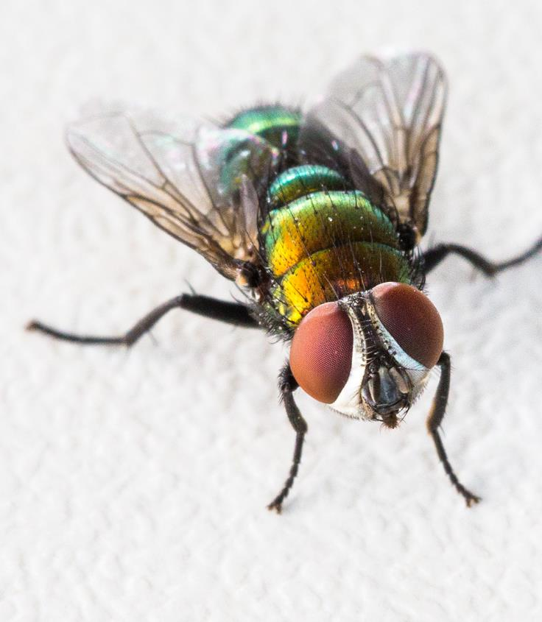
It’s fly time!™
PREVENTING, MONITORING
AND TREATING FLYSTRIKE
Notes:
This session has been developed for you to deliver as required. This may be at a group setting such as an event workshop, or one-to-one, for example with a client.
In the presentation there are notes against each slide.
Where text appears in italics, it indicates notes for you to consider or instructions. Normal text indicates the content which should be delivered with the slide.
You should run this presentation as a PowerPoint show and have the Word document with you for prompts or, if you have two screens, run in Presenter mode so you can see these notes and your audience can see the presentation.
Introduce yourself as the deliverer.

Slide 2






Today’s program
Prevention
www.flyboss.com.au
Monitoring
www.wool.com
Treatment
Notes:
At this point, welcome your participants and thank them for joining It’s Fly Time! Preventing, monitoring and treating flystrike.
This has been brought to you by Australian Wool Innovation or AWI as part of the newly released It’s Fly Time! information package designed to help woolgrowers prevent, monitor and treat flystrike.
The focus of this package is on short term measures which can be considered during a fly season.
Today’s session will cover three topics which you will shortly hear more about: flystrike -
Prevention;
Monitoring; and
Treatment.
QUESTIONS: For small groups, you can take questions as you progress. For larger groups, its recommended that you break for questions at the end of each section. The presentation has been structured to break at each section for questions.
At the end of each section, we’ll break for questions before moving onto the next section. (Change this if you intend to answer questions as they are asked throughout the presentation), please feel free to ask questions throughout the presentation.
You will hear about a number of resources available to you today, these can be accessed through the FlyBoss website or the AWI website.
Total time for full presentation is 1 hour allowing approximately 15 minutes of time in that for questions.

Slide 3
Today’s deliverer
Notes:
You can use this space to add the name, company name and logo of the deliverer if required, otherwise delete this slide.

Slide 4

Today’s program
Prevention
Monitoring
Treatment
Notes:
Flystrike is one of the most important issues facing the wool industry.
Introduce cost to industry briefly, if available or known.
Effective short-term management is made up of three key pillars, which this webinar will cover:
Prevention of flystrike, including conditions required for flystrike to occur and some key prevention activities;
Monitoring to detect flystrike; and
Treatment options when flystrike occurs.
Have a well-defined, well considered flystrike management plan which integrates these three aspects for your business, sheep and country. Don’t leave it until a crisis.
The place to start is prevention.

Slide 5



What we will cover - prevention
When flystrike risk is the highest
What makes sheep susceptible to flystrike
How to prevent flystrike
Questions
Notes:
During this section, I will cover a number of key items in relation to preventing flystrike, this includes identifying:
When flystrike risk is the highest;
What makes sheep susceptible to flystrike; and
How to prevent flystrike.
We will also have time at the end of this section for questions after which we will move on to monitoring for flystrike.

Slide 6
When flystrike risk is highest

Slide 7



Conditions required for flystrike
PRESENCE OF SUSCEPTIBLE SHEEP
PRESENCE OF
FLIES
FAVOURABLE WEATHER CONDITIONS
Notes:
There are three basic conditions required for flystrike to occur:
presence of susceptible sheep;
presence of flies; and
favourable weather conditions.

Slide 8

Weather conditions
Greater risk in:
Warm and wet conditions
Spring and autumn
Can occur throughout the year
Notes:
Let’s start with weather first.
Weather conditions play a big role in determining the risk of flystrike.
The risk of flystrike is greatest during warm and wet conditions.
This usually coincides with spring and autumn but it can occur throughout the year if climatic conditions make sheep more susceptible to flystrike and favour fly reproduction.

Slide 9



Weather conditions
Blowflies prefer:
Temperatures > 15ºC
(most active 26-36ºC)
Wind speeds < 9 km/h
(activity stops > 30 km/h)
Regular and consistent rainfall
(keeps skin moist for 2+ days)
Notes:
Australian sheep blowfly activity increases when:
the temperature is above 15ºC, but they are most active between 26ºC to 36ºC;
wind speeds are less than 9 km/h – fly activity stops when wind is greater than 30 km/h; and
rainfall is regular and consistent – the strike risk increases dramatically when there is enough rain to keep the sheep’s skin moist for two or more days.
Frequent, light falls of rain is more conducive to flystrike than occasional heavy falls because there is less opportunity for the skin to dry out.
High risk regions are predominantly in southern Australia, particularly in southern Western Australia, South Australia, Victoria and New South Wales.

Slide 10
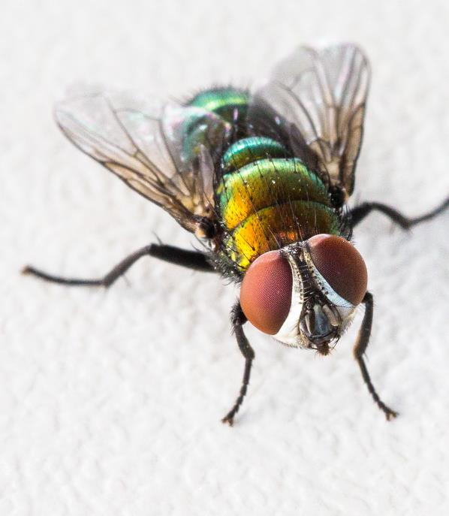
Presence of flies
The main culprit of flystrike:
Australian sheep blowfly
(Lucilia cuprina)
Notes:
That covers weather conditions which is one of the requirements for strike.
We will now talk about the next condition required for flystrike which is the presence of flies.
You will hear more about the culprit as we work through today’s presentation but let’s introduce you to Lucilia cuprina.
A pretty name but this fly, generally known as the Australian sheep blowfly, is responsible for initiating 90% of flystrike in sheep.
As you can see, it’s a very distinctive looking blowfly.
After the Australian sheep blowfly has initiated a strike, other fly species may attack the animal and can cause additional damage which is sometimes more severe.

Slide 11
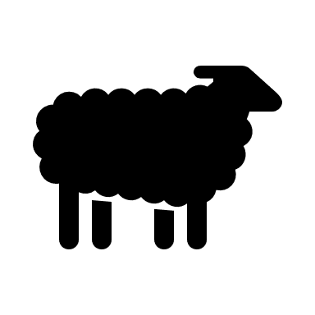

Presence of susceptible sheep
Some sheep are more inclined to be struck.
More sheep at risk…
The greater risk of fly wave and flystrike
Notes:
The final requirement for flystrike is susceptible sheep.
Some sheep are more inclined to be struck than others and are more at risk than others.
The number of susceptible sheep is a key factor influencing the extent of flystrike in a mob.
The more sheep at risk in the mob, the greater the risk of a fly wave occurring.

Slide 12
What makes sheep susceptible to flystrike
Notes:
So what makes sheep susceptible to flystrike?

Slide 13
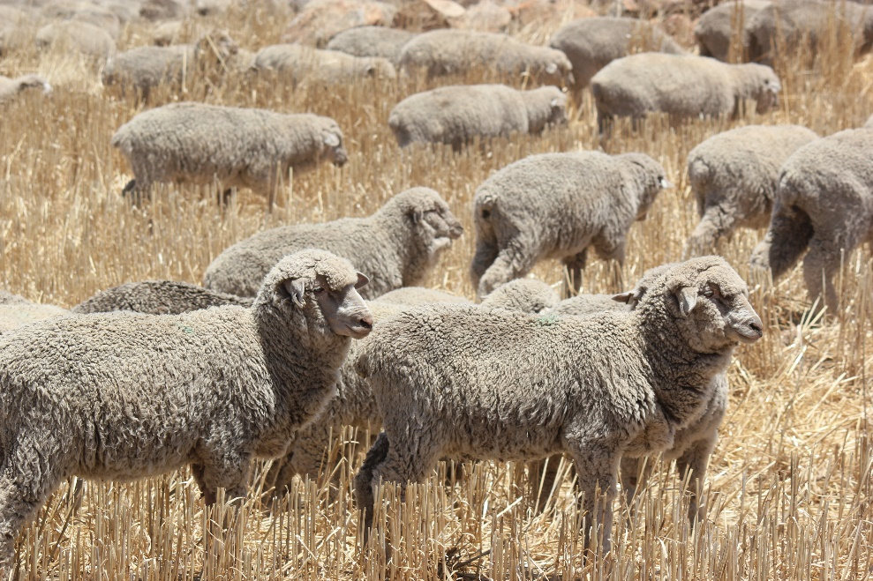
Sheep at risk
Those with:
Breech wrinkles or long wool
Dags, urine stain or yellow wool
Fleece rot and dermatitis
Wet or moist wool and skin
Wounds
Young sheep and sheep that have been struck before
are also more susceptible to flystrike
Notes:
Sheep that are more likely to be struck by flies are those that have:
breech wrinkles;
long wool in the breech area;
dags caused by scouring;
urine stain;
wool that is yellow;
fleece rot and dermatitis;
wet or moist wool and skin (greater risk of body strike);
horns; and
Wounds, for example, wounds caused by skin tears, abscess, dog bites or footrot, etc.
Basically any wound or moist skin will attract blowflies.
Sheep that have been struck in the past may also be more susceptible.
Flies use scent to find sheep, so wet sheep or those with existing strike are more attractive to them.
Young sheep like weaners are generally more likely to be struck especially those who are unclassed.

Slide 14
How to prevent flystrike
Notes:
Let’s have a look at how you can prevent flystrike.
Avoid the panic – prevention is better than the cure.
Having an integrated flystrike management plan with broad ranging tools helps minimise strike without an over reliance on chemicals.

Slide 15
Classing and lamb marking
Reducing fly populations
Shearing
or crutching
Prevention
activities
Careful paddock selection
Applying preventative chemicals
Reducing scouring risk
and dags
Notes:
Preventative activities which help reduce the risk of flystrike include:
classing and lamb marking which includes breeding and selecting sheep which are less susceptible to flystrike, as well as mulesing high risk sheep and docking lambs tails to the optimal length when marking;
shearing or crutching to reduce wool length so wool dries more quickly, particularly around the breech. This also reduces the prevalence of dags;
applying preventative chemicals to sheep to protect against strike;
reducing the risk of scouring which causes dags;
careful selection of paddocks; and
reducing fly populations.
Let’s have a closer look at each of these preventative activities.

Slide 16
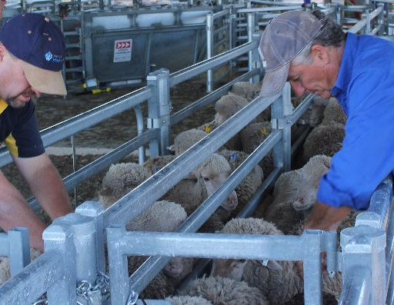
Classing - Breeding and selection
Long term - breed and select sheep for:
Low breech wrinkle and cover
Dags and stain
Productivity
Cull sheep that have been
struck previously
Notes:
Selecting and breeding sheep which are less susceptible to flystrike is a good long-term strategy to minimise flystrike.
This includes selecting for low breech wrinkle and wool cover and low incidence of dags and stain.
Culling sheep which have previously been struck is also advisable.

Slide 17
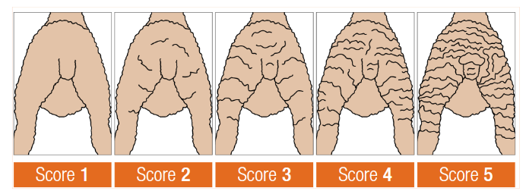
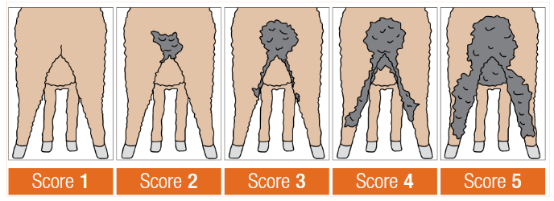
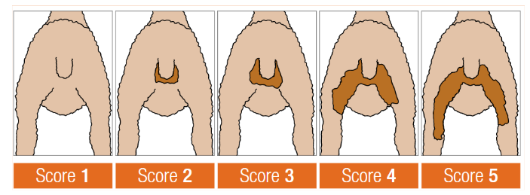
Class out high risk sheep - examples
Breech wrinkle
Dags
Urine stain
Breech cover
Source: AWI/MLA Visual Score Guide
Notes:
The AWI/MLA Visual Score Guide has some good examples of the type of sheep which would be at higher risk of flystrike.
This Guide can be used to assist selecting and classing out sheep in order to prevent flystrike long-term.
The top left image shows various degrees of breech wrinkle.
The top right shows dags.
Bottom left shows urine stain.
And the bottom right shows breech cover which is how much naturally bare skin there is around the breech.
You can see here that those sitting around score 3 or greater are going to be at increasing risk of flystrike so you would use these scores as guides for removing higher risk sheep from the flock.

Slide 18
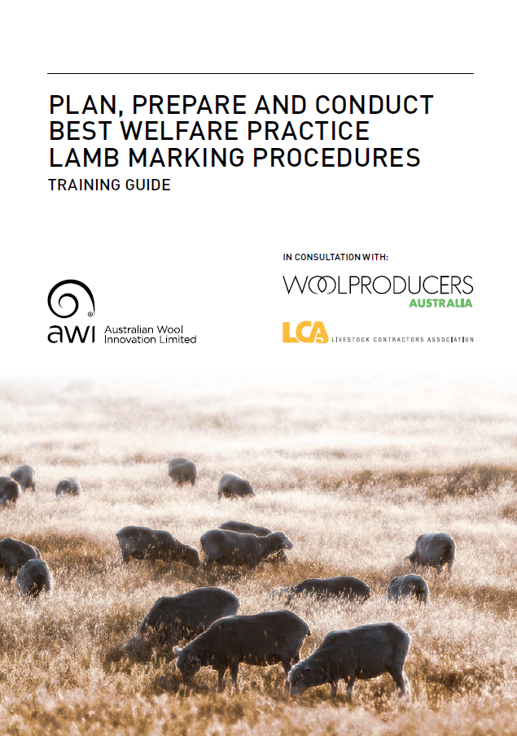

Lamb marking - Mulesing
If you deem the risk of flystrike in your sheep is high and they require mulesing - ensure that best practice procedures are used.
Two guides are available from AWI
http://bit.ly/BP-Lamb-Marking
http://bit.ly/Plan-Non-Mulesed
Notes:
If you deem the risk of flystrike in your sheep is high and they require mulesing - ensure that best practice procedures are used.
Two guides are available from AWI which will help
The first is a training guide to help you plan, prepare and conduct best welfare practice lamb marking procedures.
The second is a guide to provide assistance when planning for a non-mulesed Merino enterprise.

Slide 19
Lamb marking - Tail docking
Optimal tail length helps:
Channel urine and faeces away from breech area
Minimise breech stain and reduce flystrike
Protect from sun exposure and cancer
Notes:
Another long-term preventative activity relates to docking lambs’ tails to an optimal length when marking.
Wool that is stained or wet from urine and faeces can attract flies.
There is an optimal tail length which helps channel urine and faeces away from the breech area.
This also minimises stain around the breech and reduces flystrike risk throughout the sheep’s life.
It also helps to prevent prolapse (common in sheep with very short tails) and protects soft tissue from cancers caused by sun exposure.

Slide 20
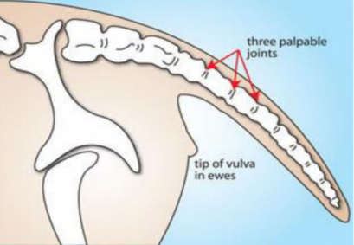
Lamb marking - Tail docking
Immediately below 3rd palpable joint
Source: FlyBoss
Notes:
When marking lambs, the recommended tail length ensures the healed tail just covers the vulva.
This means docking immediately below the third palpable joint or through the third joint space. Palpable means the joint that can be easily felt.
Male lambs should have their tails docked to the same length as ewe lambs.
The length is important because it means enough muscle remains so that the sheep can lift the tail high in the air which then puts vertical tension on the breech skin that makes the “channel” for urine.

Slide 21
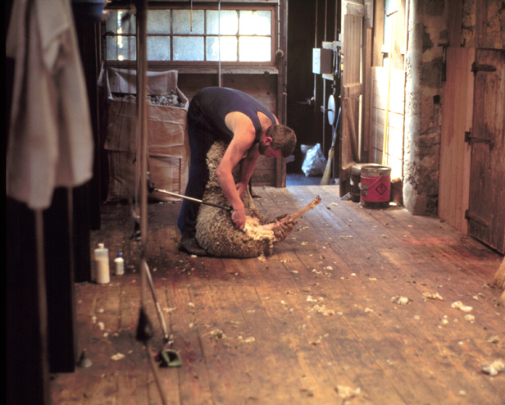
Shearing and crutching
Shearing and crutching sheep:
Protects up to 6 weeks
(reduced to 3 weeks if scouring)
Needs to be timed to extend
protection over the fly season
Consider periods of high-risk
in your area
Notes:
A short-term preventative activity is shearing and crutching.
These activities can provide up to six weeks protection from body and breech flystrike. If sheep are scouring, this protection may be reduced to three weeks.
Shearing or crutching should be planned to coincide with the start, or just before the usual start of the fly season.
This is to reduce the number of susceptible sheep when the flies become active after winter. This is particularly important for lambing ewes that may have more stain around their breech.
Carefully consider the timing of shearing and crutching.
Aim to extend the period of protection over the fly season as much as possible by ‘spacing’ out these activities, bearing in mind the usual high-risk periods for flies in your area and other critical events such as lambing.
Handling ewes with lambs at foot to crutch can be difficult so time your activities to avoid having to do this.

Slide 22
Applying preventative chemicals
Insecticides:
Are used in combination with other activities
Should not be relied upon alone
Can be used preventatively or as a treatment
Make sure you use the right
chemical for the task
Notes:
Insecticides can be used in combination with other preventative activities to deter flies but they shouldn’t be relied upon alone.
These chemicals are registered to be used as either a preventative treatment or to treat struck animals (called ‘dressings’). Some chemicals only provide protection and will not kill maggots.
We will cover treating flystrike further in this session.
It is vital you use the right chemical for the task and follow the label instructions.

Slide 23
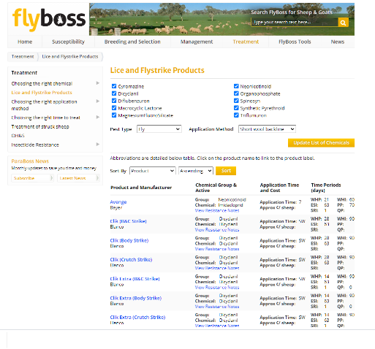
FlyBoss has tools to help chemical selection
www.flyboss.com.au
www.flyboss.com.au/sheep-goats/treatment/products
www.flyboss.com.au/sheep-goats/treatment/choosing-the-right-chemical
Notes:
As we heard earlier, you can access tools to help with chemical selection via FlyBoss.

Slide 24
Applying preventative chemicals
Points to consider when applying chemicals:
At least one month’s wool (approx. 10mm) for ideal chemical bond
Time application to extend protection
Check WHPs and other intervals - keep records
If protection period is reducing
consider a fly resistance test
Notes:
Preventative chemicals may only work if there is at least one month’s wool growth (approximately 10mm) for the chemical to bond to so applying immediately after shearing may not provide the protection expected of the product.
As we said earlier, where possible, time applications to extend the protection period.
For example, if you shear in early December, applying a preventative chemical six weeks later in mid-January will help to protect the sheep when the wool becomes long again.
When considering a chemical treatment, check for withholding periods and intervals and make sure you keep accurate records of any chemical treatments used.
If you feel the protection period is reducing, then you may want to consider conducting a fly resistance test.
Given shearer shortage (in news recently) growers may ask if any prevention chemical can be used to hold them over until they can get shearers – FlyBoss doesn’t have any information. Options include checking stock daily, using spynosin wound dressing, choosing the lowest risk paddock and pulling in favours with the growers network to secure shearers or a crutching trailer.
NSW DPI is offering sheep blowfly insecticide resistance testing to Australian woolgrowers.
More information is available from the FlyBoss website: http://www.flyboss.com.au/sheep-goats/news/articles/flyboss-featured-articles/free-tests-are-your-sheep-blowflies-resistant-to-chemicals.php

Slide 25





Chemical resistance is a growing concern
Use the right chemical
Follow label instructions
Do not overdose or underdose
Ensure full coverage
Calibrate equipment
Regular monitoring is important even with preventative chemicals
Notes:
The resistance of flies to chemicals is a growing concern, because resistance reduces the effectiveness of preventative chemicals and treatments or dressings over time.
If woolgrowers already have resistance on their property, this could result in shorter periods of protection than what they could normally expect, rather than a complete loss of effectiveness.
That is why it is important to use the right chemical for the task and rotate chemicals wherever possible.
It’s also important to:
ensure full coverage;
follow the label instructions for dosage rates and application methods;
calibrate application equipment regularly as this will help ensure the right dose is applied.
It’s vital that you don’t overdose or underdose and the steps I’ve just mentioned will help ensure this doesn’t occur.
Poor efficacy is often attributed to resistance when in fact the real issue is the application, dose rate or timing of the application.
Regular monitoring is important even with the application of preventative chemicals.

Slide 26
Do you think flystrike preventative chemicals still work
on your property for the protection period listed on the label?
Notes:
This is a question for your audience to consider.
This question is about the audience’s property and whether they think preventative chemicals work or if they may have a resistance problem. It’s important that they’re honest because - it’s tempting to blame resistance when other management issues might be at play.
Ask your audience the question: “Do you think flystrike preventative chemicals still work on your property for the protection period listed on the label?”
Ask for a show of hands or nods to indicate yes, no, unsure.
Allow time for people to answer.
If you use this question in a group setting, it’s good to get a sense of how many answered yes or no as this will be helpful in the next slide.
So roughly X% said yes which means chemicals still work on their property and X% said no which means they may have a chemical resistance problem.

Slide 27
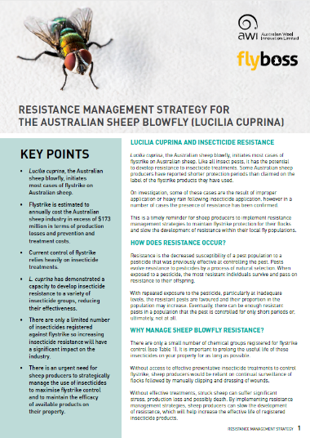
Chemical resistance
Do you think chemicals still work on your property?
Read Resistance management strategy available from www.flyboss.com.au
Search “resistance management strategies”
Notes:
For those who think chemicals still work on your property there is a great resource available which covers how to strategically manage the use of chemical treatments to reduce the risk of a resistance problem developing.
Essentially, if you don’t have a resistance problem, you don’t want to develop one so this factsheet will give you some tips about avoiding that.
You can download the factsheet from flyboss.com.au – just search resistance management strategies.
http://www.flyboss.com.au/sheep-goats/files/pages/treatment/insecticide-resistance/resistance-management-strategies/190415-SHEEP-BLOWFLY-RESISTANCE-MANAGEMENT-STRATEGY-FINAL-GD3349.pdf

Slide 28
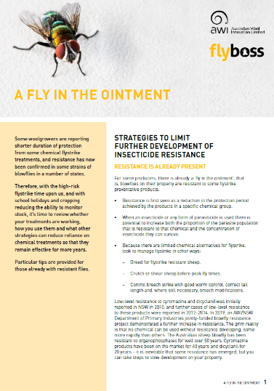
Chemical resistance
Do you think resistance might be increasing on your property?
Read A fly in the ointment available from www.flyboss.com.au
Search “resistance management strategies”
Notes:
For those that indicated you think you already have a resistance problem developing on your property there is another resource available for you which covers other strategies you can use to limit the development of further resistance on your property.
You can download the factsheet A fly in the ointment from flyboss.com.au – just search resistance management strategies:
http://www.flyboss.com.au/sheep-goats/files/pages/treatment/insecticide-resistance/resistance-management-strategies/GD4044-Fly-in-the-Ointment-Factsheet-3.pdf

Slide 29
Classing and lamb marking
Reducing fly populations
Shearing
or crutching
Prevention
activities
Careful paddock selection
Applying preventative chemicals
Reducing scouring risk
and dags
Notes:
We have discussed:
classing and lamb marking which includes breeding and selecting sheep which are less susceptible to flystrike, as well as mulesing high risk sheep and docking lamb’s tails to the optimal length when marking;
shearing or crutching to reduce wool length so wool dries more quickly;
applying preventative chemicals to sheep to protect against strike;
It’s now time to consider:
reducing the risk of scouring which causes dags;
careful selection of paddocks; and
reducing fly populations.

Slide 30
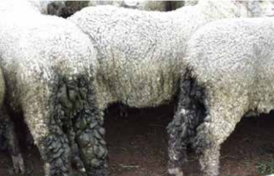
Reducing scouring risk and dags
➔
Scouring leads to dags
Breech stays warm and moist
Ideal conditions
to attract flies
Notes:
Another preventative activity is reducing souring.
Scouring can cause dags to form rapidly.
Dags can then cause the wool and skin around the breech to stay moist and warm, this creates an odour which attracts the gravid fly looking to lay eggs. This environment provides a suitable site for female flies to lay eggs and for maggots to develop.
Preventing scouring and dags is an important step to improve animal welfare and reduce the risk of breech strike.

Slide 31


Reducing scouring risk and dags
Monitor worm populations
Drench appropriately
Rotate drenches - use multi-actives
Avoid sudden changes in diet
Notes:
Worms can cause scouring so controlling the risk of scouring is an important preventative activity.
If you live in an area where there is a high risk of dags occurring, add lowering dags into your breeding objective.
To control worms you need to:
Monitor worm populations using faecal egg counts and drench when required.
When drenching, remember to use the right drench for the job and the right dose.
Rotate drenches and use drenches with multi-actives when possible. More information on this can be found at wormboss.com.au
Avoid sudden changes in diet that may induce scouring such as the introduction of grain or forage crops.

Slide 32
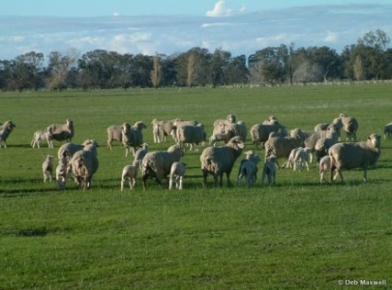
Careful selection of paddocks
Select paddocks which:
Are open with more wind
Have less ground cover, timber and
wet areas
Do not have large worm populations
Source: FlyBoss
Notes:
Putting more susceptible sheep in certain paddocks is another key prevention activity.
Select paddocks that help mitigate the environmental factors that contribute to flystrike and avoid hotspots that encourage fly activity.
This might include paddocks that are more open and exposed to wind and those with less timber and wet areas.
Fly activity will be reduced in these paddocks and sheep will dry out more quickly.
Avoid paddocks that may be contaminated with a large worm population (for example, those that have been recently grazed) during the fly season. This will help prevent scouring.

Slide 33
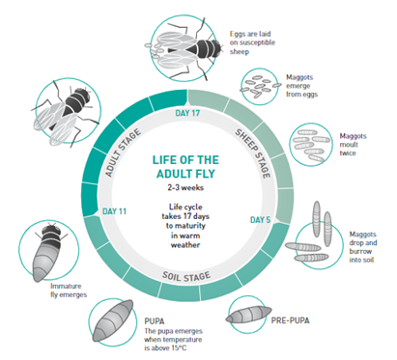
Reducing the presence of flies
The lifecycle of Lucilia cuprina, the Australian sheep blowfly
Source: Levot (1999) from Managing Breech Flystrike (2019), AWI
Notes:
The final preventative activity I’ll cover is focused on reducing the presence of flies.
The Australian sheep blowfly female prefers to lay its eggs on live sheep. Damp, smelly wool is their ideal environment.
A female can lay 300 eggs every 4-8 days which explains how “fly waves” can quickly escalate.
Within 12-24 hours, the eggs hatch into maggots (larvae) which grow by feeding on the sheep through wounds, existing strike and weeping skin.
The maggots drop off the sheep in about three days and burrow into the ground to pupate before emerging as immature flies about a week later, depending on temperature.
To complete their lifecycle, larvae need a feed rich in protein to commence their lifecycle.
The sources of protein include exudate from wounds, existing strikes, weeping skin, carcases and protein-rich manure.
Other fly species that can cause secondary infections may also use these sources of protein (including carcases, animal and household waste) to lay eggs and to hatch maggots.

Slide 34


Reducing the presence of flies
REMOVE and dispose of infected material and carcases
COLLECT and kill
any maggots
MANAGE at isolated sites to make a difference across a bigger area
Notes:
Removing flies from the equation can help to prevent strike in the first place.
Some key points for reducing the presence of flies:
Remove and dispose of any fleece or waste animal matter (dags, dirty wool, horn tips, tails etc) to eliminate these as a source of protein for both the Australian sheep blowfly and other flies. Carcases of sheep that have died from flystrike should also be removed and disposed of – ideally by burying them. Although carcases aren’t a big part of the lifecycle for the Australian sheep blowfly, many maggots may be able to complete their development before other fly species infect the carcase and out compete them.
Collecting maggots from wool clippings when you’ve treated an animal is also important. It might not be something you automatically think about but doing this helps reduce the number of flies and can prevent a fly wave. Prevention is better than treatment.
Remember that flies do not generally travel far (about 3km) so managing them at isolated sites and at a property level can make a significant difference to the level of flystrike on individual properties and in the local area.
Importantly, these activities which help reduce fly populations should be timed before the first emergence of flies from the pupae stage - not just within the fly season.
Reducing the feed source by disposing of fleece, waster matter and carcases is important before temperatures reach above 15oC – that is, towards the end of winter and not just once spring has sprung when we think flies are about.
If you starve the newly emerged flies you slow the population reproductive rate over the next few months – by the end of the fly season your local population size (and therefore fly pressure) will be lower. Then you will have even less flies that have survived winter to emerge the following winter/spring when over 15ºC.

Slide 35
Classing and lamb marking
Reducing fly populations
Shearing
or crutching
Prevention
activities
Careful paddock selection
Applying preventative chemicals
Reducing scouring risk
and dags
Notes:
So that covers the full range of prevention activities.
A combination of these activities is best rather than relying on any single activity alone and should be considered in your integrated flystrike management plan.
Don’t forget, at the end of the fly season, reassess your flystrike management plan and make changes where necessary.

Slide 36

Take to the farm messages
1
Well-timed, preventative activities can help reduce the risk of flystrike
2
Some types and classes of sheep
are more susceptible to flystrike
3
A well thought out integrated flystrike program is crucial
Notes:
Now to summarise what we’ve discussed for prevention:
Well-timed preventative activities can help reduce the risk of flystrike and the development of fly waves.
Some types and classes of sheep are more susceptible to flystrike and should be targeted for preventative treatment.
A well thought out integrated flystrike program is required, make sure you have a plan which includes preventative activities we’ve covered today.

Slide 37
Take to the farm messages
4
No single preventative activity should be relied upon alone
5
Monitoring is required even with the use of preventative activities
6
Flystrike management considers prevention, monitoring, treatment
Notes:
No single preventative activity should be relied upon alone – make sure you use a range of well-timed activities in combination.
Monitoring activities (which we will hear about next) are still required even with the use of preventative activities including the use of preventative chemicals. Constant vigilance is crucial.
Effective flystrike management requires the combination of prevention, monitoring and a treatment – which we will shortly cover.

Slide 38
Questions
Prevention
Monitoring
Treatment
Notes:
That brings us to the end of our section on prevention so we’ll check for questions before moving onto Monitoring.
Asks for questions from participants about what has just been covered and provide answers. You may need to go back to slides to reinforce messages.

Slide 39
Progress check
Prevention
Monitoring
Treatment
Notes:
We’re going to look at monitoring activities to control flystrike.

Slide 40

What we will cover - monitoring
Why monitoring is important
How to monitor for flystrike
Signs of flystrike
Questions
Notes:
During this section, I’ll cover a number of key items in relation to monitoring flystrike, this includes identifying:
why monitoring is important and the role it plays in short term flystrike management;
how to monitor for flystrike; and
the signs of flystrike.
We will also have time at the end of this section for questions before we move onto the final section regarding treatment of flystrike.

Slide 41
Why monitoring is important
Notes:
Let’s look at why monitoring is important.

Slide 42
The aim of monitoring
Detect and deal with flystrike as soon as possible to prevent:
Further suffering in flystruck animals
Increased flystrike across the flock
Negative impacts on:
  wool production
  condition and fertility
  growth and survival
Notes:
Monitoring flystrike is an important tool for woolgrowers to use, particularly when conditions indicate an increased risk of flystrike.
The aim of all monitoring activities should be to detect and deal with flystrike as soon as possible.
Doing so means you can:
stop the flystrike from worsening in individual animals and prevent further suffering of flystruck animals;
prevent fly populations increasing and flystrike spreading through the entire flock or your area – it’s better to prevent than have to treat the outcome; and
avoid negative impacts on wool production, condition, fertility, growth and survival due to poor health or damage from strike.

Slide 43
How to monitor for flystrike
Notes:
So, how do you monitor for flystrike?

Slide 44
Monitor conditions required for flystrike
MONITOR STRIKE
IN SHEEP
MONITOR FLY
POPULATIONS
MONITOR WEATHER CONDITIONS
Notes:
Monitoring flystrike really means monitoring the conditions required for flystrike.
Remember, the conditions required are:
The presence of susceptible sheep;
The presence of flies; and
Favourable weather conditions.
Monitoring therefore means:
Monitoring strike in sheep;
Monitoring fly populations; and
Monitoring weather conditions.

Slide 45


Monitor flystrike in sheep
CHECK SHEEP
1
2
LOOK FOR SIGNS
Regularly check sheep
in paddocks
Check the sheep for signs
of flystrike
Regularly check
sheep
Look for
signs of flystrike
TREAT ALL SHEEP
4
3
TREAT THE SHEEP
If strike occurs across a large number, treat the entire mob.
Remove struck sheep
for treatment.
Or treat the whole
mob
Treat the individual sheep
Notes:
Regularly checking mobs of sheep and carefully looking for signs of flystrike is an important part of flystrike management.
This is a particularly important activity when favourable conditions for flies occur.
Not only will this allow you to identify and deal with struck sheep but it will also allow you to monitor the severity of the flystrike event. That is whether it is a one-off event or if it’s a sign of an imminent outbreak.
Checking sheep doesn’t mean bringing the sheep into the yards but rather going around the paddocks carefully and looking at the sheep for signs of flystrike.
If you find signs of flystrike in sheep, remove the sheep for treatment.
If the strike appears to be more extensive and across a large portion of the flock, then you may need to bring the entire mob in for treatment.

Slide 46
Signs of flystrike
Notes:
When you are monitoring flystrike in sheep, it’s important to understand the signs of flystrike and how severe it is.

Slide 47
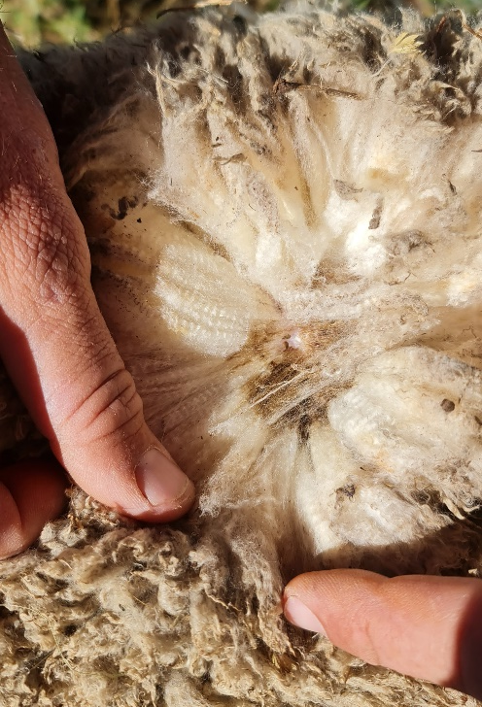
Covert flystrike
Covert flystrike is:
Common
Not easily seen unless looking closely
Covert strikes can last for some
weeks and advance or resolve
Covert flystrike can be difficult to
detect unless handling sheep
Notes:
Small areas of flystrike that cannot be detected easily are quite common and are known as covert flystrikes.
They are difficult to detect unless you are looking closely at sheep, such as when handling them for crutching, shearing or marking.
Covert strike can last for some weeks before advancing into more obvious flystrike during warm, moist conditions or they can resolve without the need for treatment.

Slide 48
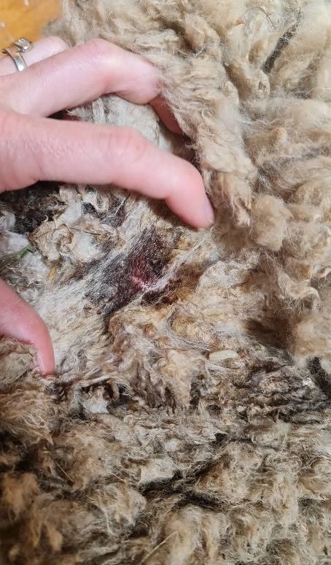
Early detectable flystrike
Early detectable flystrike signs:
Discoloured wool
Sheep behaviour
As soon as detected, implement
treatment and prevention
Discoloured wool may indicate early
detectable flystrike
Notes:
Early signs of flystrike which should be noted in a monitoring program including patches of wool that appear discoloured from chewing or rubbing.
These generally do not have a large strike wound but it will become progressively darker with more exudate (weeping).
Sheep also usually behave differently as they will be uncomfortable and irritated. They may twitch their tail, bite or scratch at the affected area if they can reach it, especially with breech strike. They may also stamp their feet, duck their head and arch their backs but will generally stay with the mob.
As soon as an early detectable strike is confirmed, implement treatment activities and take steps to prevent further flystrike from occurring.

Slide 49
Early detectable flystrike
Act now to prevent advanced strike:
Treat struck sheep
Work out cause of strike
Crutch or apply preventative chemicals
If a fly wave is likely, increase
monitoring and prevention
Notes:
Start by treating all struck sheep and then work out why the strike has occurred.
This allows you to determine whether it is an anomaly, that is only one particularly susceptible sheep is affected, or if it is an indicator that an outbreak is imminent.
If the strike appears to have affected more than one particularly susceptible sheep, consider whether the strike occurred due to a management error (for example: poor or delayed crutching or chemical application error) or if it’s due to a ‘fly wave’? This can help determine what the next course of action may be.
If you think an outbreak or fly wave might happen, increase monitoring and take action such as crutching or chemical preventions as soon as possible.
If shearers cannot be arranged, consider alternative options, such as additional jetting with a preventative treatment which may provide interim protection until shearing or crutching can be arranged.

Slide 50
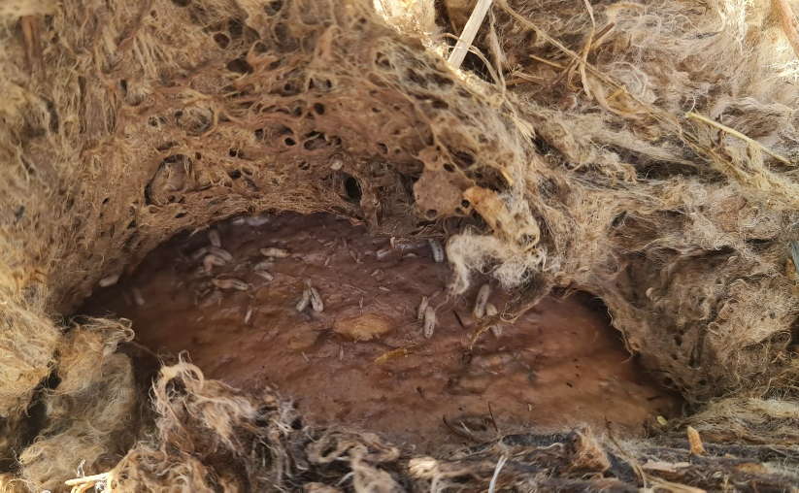
Advanced flystrike
Signs of advanced flystrike:
Wound is large, wet, dark and smelly
Affected area is swollen and inflamed
Isolation, fatigue and loss of appetite
Treat immediately to promote
An obvious wound site
wellbeing - increase monitoring
Notes:
The signs of advanced strike are more obvious because the wounds are larger and the toxins released by maggots can cause ‘whole of body’ effects for the sheep including fever and potentially sepsis or septic shock.
Wounds from advanced strike are large, wet, dark and smelly and maggots will be moving outwards to consume healthy tissue. Affected areas will be swollen and inflamed due to the toxins released by the maggots.
Sheep will be suffering significant pain and inflammation, as well as fever and other whole of body effects.
Sheep won’t be able to keep up with the mob when grazing and will often be found on their own. They will become increasingly affected by the flystrike, stop eating and drinking, will lie down and not want to get up.
Without treatment, sheep will generally die quickly, anywhere from hours to three or so days. If sheep with advanced flystrike are found, treat animals immediately and increase the frequency of monitoring as it is likely that more flystrike will occur in the following days or weeks.

Slide 51
Monitor conditions required for flystrike
MONITOR STRIKE
IN SHEEP
MONITOR FLY
POPULATIONS
MONITOR WEATHER CONDITIONS
Notes:
That that covers monitoring sheep, let’s have a look at monitoring fly populations.

Slide 52
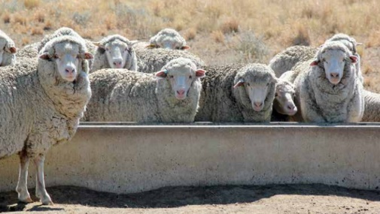
Monitor fly populations
Regularly check:
Sheep camps
Watering points
Fly traps (where used)
Sheep watering points and
camps attract flies
Watering points act as
epicentres for infection
Notes:
Adult flies do not normally travel further than 3 km so sheep camps and watering points can act as epicentres for infection. Check these areas regularly for blowflies and struck sheep.
Remember – part of the lifecycle is maggots that drop off struck sheep and form pupae in the soil. So, it makes sense that where sheep spend a lot of time will be where a lot of flies develop.
Fly traps are a useful tool to monitor fly activity in northern areas of NSW and Qld but are less useful in southern regions.
If any Australian sheep blowflies are caught in traps or found around camps and watering points, this should be taken as a warning that flies are about and, given favourable conditions, flystrike could occur.

Slide 53
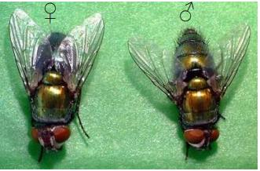
Monitor fly populations – adult flies
An adult female (left) and male (right) Australian sheep blowfly
Source: J Larsen, L Tyrell and N Andersen, The Mackinnon Project, University of Melbourne, from Early Season Treatment and the Control of Breech Strike in Unmulesed Sheep – A National R&D Technical Update (2010), AWI
Notes:
When monitoring fly populations, it’s important to know how to spot the different fly species so you can determine if the Australian sheep blowfly is about.
Many of you will be familiar with the Australian sheep blowfly but as a recap:
The adult Australian sheep blowfly is about 9 mm long (body length) and is a metallic green/bronze colour with reddish eyes.
You can see here the very distinctive colour.

Slide 54
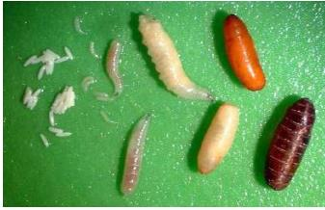
Monitor fly populations - blowfly larvae
Various stages of Australian sheep blowfly larvae development
Source: S De Cat and J Larsen, The Mackinnon Project, University of Melbourne,
from Managing Breech Flystrike (2019), AWI
Notes:
Egg-bearing female flies lay small white eggs on live sheep.
These larvae or maggots are creamy coloured and hatch within 12-24 hours of the eggs being laid.
The maggots drop off the sheep after about three days (around 13 mm in length) and burrow into the ground to pupate. The pupa become barrel-shaped as the outside shell hardens and darkens from yellow to red-brown.
When conditions are favourable, they emerge as immature flies about one week later.

Slide 55
Monitor conditions required for flystrike
MONITOR STRIKE
IN SHEEP
MONITOR FLY
POPULATIONS
MONITOR WEATHER CONDITIONS
Notes:
That covers monitoring fly populations, let’s have a look at monitoring weather conditions.

Slide 56




Monitor weather conditions
REMEMBER - Blowflies prefer:
Temperatures > 15ºC
Wind speeds
< 9 km/h
Regular and consistent rainfall
Monitor sheep carefully when
favourable conditions occur
Notes:
Remember from the prevention section, consecutive warm, calm, wet days above 15ºC provide ideal conditions for female flies to lay eggs on sheep and are a good indicator that strike may occur.
Monitoring the weather helps you to know in advance when conditions are likely to favour flies.

Slide 57
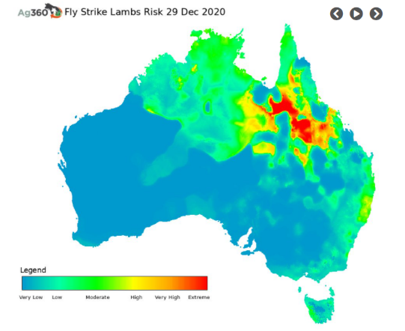
Check your risk at FlyBoss
Access free national risk
maps for flystrike
via FlyBoss
www.flyboss.com.au/sheep-goats/management/national-risk-maps
Notes:
A forecast of wetter than average conditions can be a valuable indicator of increased fly activity.
This summer is predicted to be wet for most of the eastern states. This is likely to extend the fly season and increase the risk of flystrike.
You can access free national risk maps for flystrike via FlyBoss.
It is recommended that you use the most current map available when presenting, or visit the site live:
http://www.flyboss.com.au/sheep-goats/management/national-risk-maps.php

Slide 58
Monitor conditions required for flystrike
MONITOR STRIKE
IN SHEEP
MONITOR FLY
POPULATIONS
MONITOR WEATHER CONDITIONS
Notes:
And they are the key monitoring activities you need to be undertaking regularly.

Slide 59
Take to the farm messages
1
Monitoring activities help detect signs and conditions of flystrike
2
Monitoring is a combination of checking sheep, flies and weather
3
Monitoring is important even with the use of preventative activities
Notes:
Now to summarise what we’ve heard for monitoring:
Regular monitoring activities will help you to detect signs of flystrike in sheep as well as conditions which may favour flystrike. Finding these as early as possible helps prevent severe infections.
Monitoring involves a combination of checks including looking for flystrike in sheep, checking populations of flies and checking weather conditions.
Monitoring is an important activity to undertake regularly even with the use of preventative activities including chemicals.

Slide 60
Questions
Prevention
Monitoring
Treatment
Notes:
That brings us to the end of our section on monitoring so we’ll check for questions before moving onto treatment.
Asks for questions from participants about what has just been covered and provide answers. You may need to go back to slides to reinforce messages.

Slide 61
Progress check
Prevention
Monitoring
Treatment
Notes:
We’ve now covered prevention and monitoring so in this next section we’ll look at treating flystrike when it occurs.

Slide 62

What we will cover - treatment
How to treat flystruck sheep
What chemical treatment to use
How to treat the cause of additional strike
Overall questions
Notes:
Treating flystrike is essential to protect the health and welfare of your flock, break the lifecycle of flies and prevent economic losses.
In this section, we will look at how to treat flystruck sheep including how to select suitable chemical treatments.
We will also review how to kill maggots and remove sources of protein to help break the lifecycle of flies and prevent additional strike.

Slide 63
How to treat flystruck sheep
Notes:
So, you have been monitoring your sheep and you find a flystruck one, what do you do next?

Slide 64

Steps to follow
1
CLEAN THE STRIKE AREA
Clip wool close to the skin on the strike area and 5cm into clean wool around the site.
2
COLLECT & KILL MAGGOTS
CLEAN STRIKE AREA
Put wool and maggots into plastic bag, seal and leave in sun to kill maggots.
COLLECT & KILL MAGGOTS
MOVE TO ‘HOSPITAL’
4
MOVE TO ‘HOSPITAL’
DRESS INFECTED AREA
Move struck, treated sheep to a hospital paddock to reduce risk to rest of flock.
3
DRESS INFECTED AREA
Dress the infected area using suitable registered chemical to prevent restrike.
Notes:
The first step is to clean the strike area.
This means the area of the strike wound and around the site.
Remove struck wool by clipping the wool on and around the infected area. Clip the wool close to the skin. Machine shearing with a hand piece is generally better than using manual hand shears.
Clip into at least 5 cm or one blow with a handpiece, of clean wool around the struck area to ensure all maggot trails have been exposed and create a buffer so the infected skin can dry out.
If you find maggot trails, follow these and clip out all infected wool.
Many maggots may escape treatment if care is not taken. Poor control of maggots can lead to further strike as well as resistance to treatment and prevention chemicals.
It is important to collect as many maggots as possible during treatment and kill them.
Don’t just kick the maggots and wool clippings down the chute if you’re in the shed.
To dispose of maggots effectively, place all clipped wool and all maggots into a plastic bag that can be sealed.
Leave the bag in the sun for several days to kill the maggots.
Once you’ve cleaned the site and cleaned up the wool and maggots, the next step is to dress the infected area.
Dress the infected area using a suitable registered chemical to prevent the wound from being restruck while it is healing.
After dressing the wound, you then need to move struck sheep to a ‘hospital’ paddock (if possible) to reduce the risk of attracting more flies to the rest of the flock. Provide the treated sheep with fresh feed and water, shelter and contact with other sheep and monitor them regularly.
For treating sheep with severe flystrike, it is best to consult your local vet as these sheep are at greater risk of death.
Make sure you follow all the steps described to effectively treat struck sheep, prevent additional strike and avoid the development of resistance to chemicals.

Slide 65
What chemical treatment to use
Notes:
Now let’s have a look at what chemicals you can use.

Slide 66
Dressings
Chemical treatments or ‘dressings’:
Help prevent restrikes
Provide short-term protection
Shouldn’t be relied upon alone
Keep records of treatments
Notes:
Chemicals are registered to be used as either a preventative measure (which we’ve heard about) or to treat struck animals as what’s called a ‘dressing’.
Dressings can help kill existing maggots and prevent re-strike while the wound dries out and heals but may only provide protection for a relatively short period of time.
When considering a dressing, check for withholding periods and intervals.
Dressings should be used in combination with other measures and shouldn’t be relied upon alone.
The active ingredients in registered dressings are:
cyromazine;
spinosad;
ivermectin; and
diazinon.
Remember to keep accurate treatment records.

Slide 67
REMEMBER
Access tools to help with
chemical selection
via FlyBoss
www.flyboss.com.au/sheep-goats/treatment/products
www.flyboss.com.au/sheep-goats/treatment/choosing-the-right-chemical
Notes:
As we heard earlier, you can access tools to help with chemical selection via FlyBoss.

Slide 68
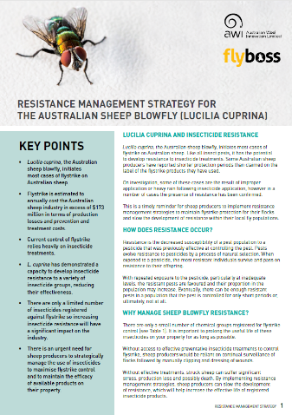

Chemical resistance
REMEMBER
Chemical resistance is a
growing concern
Some chemicals won’t
kill maggots
www.flyboss.com.au
Notes:
Also remember that resistance of flies to chemicals is a growing concern as resistance reduces the effectiveness of treatment over time.
That’s why it’s important to use chemicals properly for treatment, the same as prevention.
Be aware that some chemicals used as dressings may not kill maggots.
Don’t forget the two factsheets you heard about earlier in relation to chemical resistance which are available by searching for “resistance management strategies” on FlyBoss.

Slide 69
How to treat the cause of additional strike
Notes:
Another important treatment activity is treating the cause of additional strike.

Slide 70
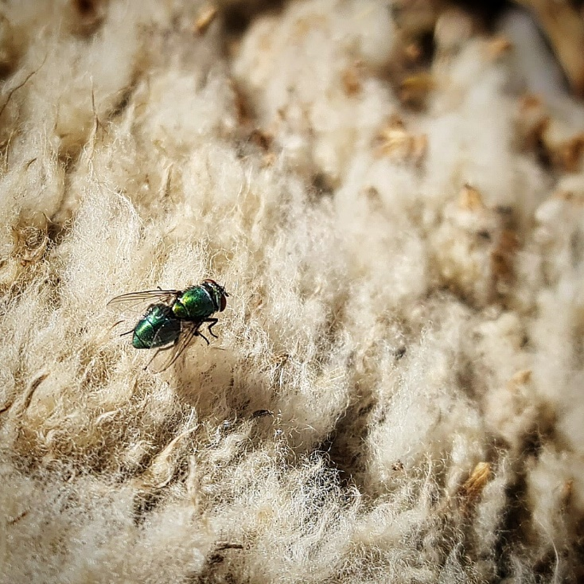
Break the blowfly lifecycle
Prevent further strike:
Remove protein sources
Destroy maggots
Effective control prevents
the spread of flies
Notes:
Remember, to complete their lifecycle, female adult flies must have access to feeds that are rich in protein.
Preventing additional strike means breaking the blowfly lifecycle by removing sources of protein including carcases, household waste and any fleece or waste animal matter (dags, dirty wool pieces, horn tips, tails etc).
Killing maggots when you treat flystrike is also very important as obviously this breaks the lifecycle.
Even maggots that have been treated with dressings should be killed as these may hatch into flies that are resistant to chemical treatments.
And remember, because flies do not generally travel far, managing them at isolated sites and a property level can make a significant difference to the broader spread of flies.

Slide 71
Take to the farm messages
1
Use a combination of treatment activities, not one single activity
2
Correctly treat sheep, kill maggots and remove protein sources
3
Flystrike management should also consider prevention and monitoring
Notes:
In summary, when it comes to treating flystruck sheep, make sure you use a combination of treatment activities and that you don’t rely on one single activity alone.
It’s important to make sure all flystruck sheep are effectively treated, all maggots are killed and sources of protein are removed to aid the sheep’s recovery and to prevent additional strikes.
Treatment of flystrike should be considered as part of a larger flystrike management plan which also incorporations prevention and monitoring activities, as we’ve heard about today.

Slide 72
Progress check
Prevention
Monitoring
Treatment
Notes:
That’s the end of our section on treatment and takes us to the end of three sections we had planned for today.
Before we move onto questions, just a final summary about key points from today.

Slide 73



Summary
Prevention, monitoring and treatment activities are all important but preventing flystrike is key.
Have an integrated plan for prevention, monitoring and treatment – review regularly
Prevention, monitoring and treatment activities consider sheep, flies and weather holistically
Notes:
Prevention, monitoring and treatment activities are all important but preventing flystrike is key.
Have an integrated plan for prevention, monitoring and treatment and review it regularly.
No single preventative, monitoring or treatment activity should be relied upon alone. Remember it’s a strategy, we’re using them all together.
These prevention, monitoring and treatment activities need to consider sheep, flies and weather holistically.
Thank you everyone for your attention, I’ll hand over to [Facilitator] and we will go through questions.

Slide 74

Questions
Notes:
FACILITATOR
Summary of key points E.g. how prevention, monitoring and treatment can’t be considered in isolation of each other and each contributes differently to effective flystrike management/getting the balance of activities right is key to effective flystrike management.
Move onto questions either on the topic of treatment which we just finished or if there are any other questions overall about prevention, monitoring and treating flystrike.
Facilitator – asks questions from participants and Deliverer answers.
[have three questions prepared]

Slide 75
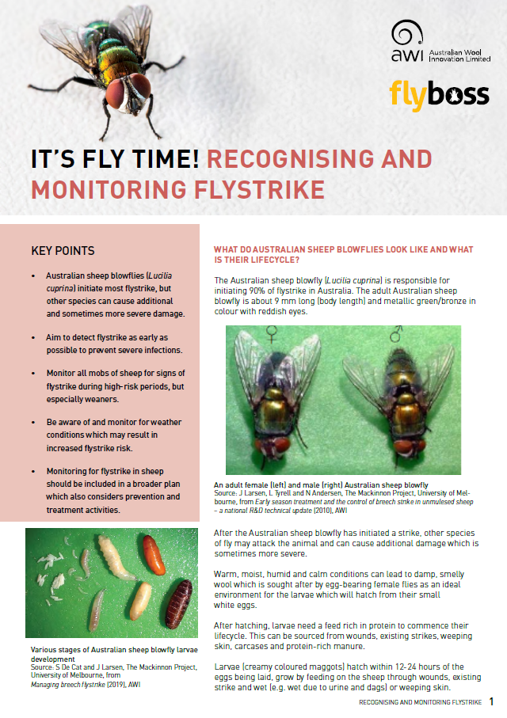
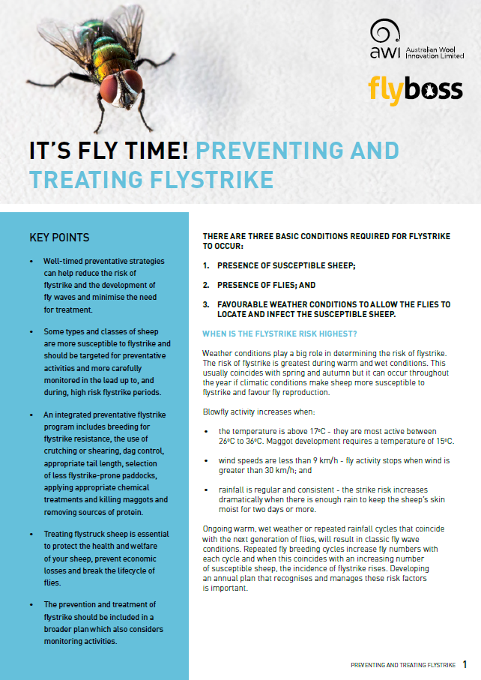
Resources
www.flyboss.com.au
www.wool.com
Notes:
In summary, when it comes to treating flystruck sheep, make sure you use a combination of treatment activities and that you don’t rely on one single activity alone.
It’s important to make sure all flystruck sheep are effectively treated, all maggots are killed and sources of protein are removed to aid the sheep’s recovery and to prevent additional strikes.
Treatment of flystrike should be considered as part of a larger flystrike management plan which also incorporations prevention and monitoring activities, as we’ve heard about today.

Slide 76

Please provide your feedback
Help us improve the presentation
by answering 5 short poll questions
Notes:
Thank you everybody for your attendance today.
Before we go, it would be great if you could stay on and answer five short poll questions to help us improve this presentation.
The poll results will be anonymous, we won’t be sharing or discussing them at the end like we have with other poll questions.
Did you learn something new today?
Yes
No
Do you intend to make on-farm changes as a result of today’s webinar?
Yes
No
Unsure
N/A (not a woolgrower)
Do you intent to seek further information on flystrike management as result of what you heard in today’s webinar?
How would you rate the value of the webinar to your business? (1 - not valuable, 10 – extremely valuable)
1-10
What area was of most interest to you?
Prevention
Monitoring
Treatment

Slide 77
THANK YOU
DR TIM GOLE
BVSc MANZCVS (Sheep Medicine)
FOR FLOCKS SAKE
M: 0499 FFS FFS
337 337
E: tg@flockssake.com.au
This publication should only be used as a general aid and is not a substitute for specific advice.
To the extent permitted by law, we exclude all liability for loss or damage arising from the use of the information in this publication.
© 2021 Australian Wool Innovation Limited. All rights reserved. Australian Wool Innovation Limited gratefully acknowledges the funds provided by the Australian government to support the research, development and innovation detailed in this publication. GD4088

