Slide 1
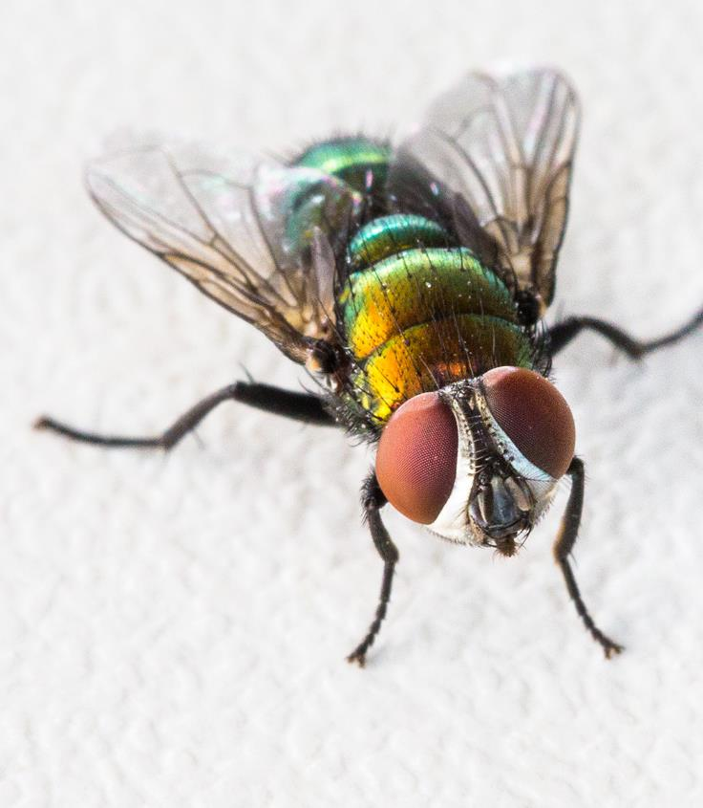
It’s fly time!™
PREVENTING, MONITORING
AND TREATING FLYSTRIKE
Notes:
FACILITATOR
Thank participants for joining.
Welcome to It’s Fly Time! Preventing, monitoring and treating flystrike.
Give an update on time to go before commencing.
Start on time.
Everyone will get the presentation emailed directly to them [where relevant].

Slide 2






Today’s program
Prevention
www.wool.com/itsflytime
Monitoring
www.flyboss.com.au
Treatment
Notes:
FACILITATOR
Welcome to It’s Fly Time! Preventing, monitoring and treating flystrike.
This has been brought to you by Australian Wool Innovation as part of the newly released It’s Fly Time! information package designed to help woolgrowers prevent, monitor and treat flystrike over the coming months/during risk periods.
The focus of this package is on short term measures which can be considered during fly season.
Introduce self as facilitator.
Mention deliverer who will shortly take participants through session.
Today’s session will cover three topics which you will shortly hear more about flystrike:
Prevention;
Monitoring; and
Treatment.
At the end of each section, there will be a break for questions.
You’ll here about a number of resources available to you today, these can be accessed through the FlyBoss website or the AWI website.
Total time for full presentation is 1 hour (or 20 minutes for each section) allowing plenty of time in that for questions.

Slide 3
Today’s deliverer
INSERT NAME AND LOGO
Notes:
FACILITATOR
I am very pleased to welcome XXX who will take you through the remainder of the session.
XXX is XXX.
I will now hand over to XX.

Slide 4
Today’s program
Prevention
Monitoring
Treatment
Notes:
Thank you [facilitator].
Flystrike is one of the most important issues facing the wool industry.
It is estimated that flystrike causes production losses of more than $227 million per year and costs more than $96 million in prevention and treatment to the industry each year. This is a total cost to the industry of $323.7m per year across and an average per head cost of $4.76.
Effective short-term management is made up of three key pillars, which this webinar will cover:
Prevention of flystrike, including conditions required for flystrike to occur and some key prevention activities;
Monitoring to detect flystrike; and
Treatment options when flystrike occurs.
Have a well-defined, well considered flystrike management plan which integrates these three aspects for your business, sheep and country. Don’t leave it until a crisis.
So – the place to start is prevention.
NOTE FOR DELIVERERS
Based on a report commissioned by MLA in 2022.
Based on 2021 costs and flock sizes.
National flock size: 68m
Total cost of flystrike estimated: $323.7m
Production losses includes mortalities, weight loss, fleece weight, wool quality and fertility.
Costs include treatment (labour and chemical dressings) and prevention (chemical applications, labour to apply chemicals, mulesing and crutching (with 50% of cost of crutching attributed to flystrike management)).
Actual: $96.3m made up of:
$12.5m in treatment costs
$83.8m in prevention costs
Reference: Priority list of endemic diseases for the red meat industry – 2022 update:
https://www.mla.com.au/contentassets/b63b9232784e4252bdcfca0aad7aa83b/bahe0327_endemic_disease_economics_update_accepted_13jul22.pdf

Slide 5



What we will cover - prevention
When flystrike risk is the highest
What makes sheep susceptible to flystrike
How to prevent flystrike
Questions
Notes:
During this section, I’ll cover a number of key items in relation to preventing flystrike, this includes identifying:
When flystrike risk is the highest;
What makes sheep susceptible to flystrike; and
How to prevent flystrike.
We will also have time at the end of this section for questions after which we will move on to monitoring for flystrike.

Slide 6
When flystrike risk is highest

Slide 7


Conditions required for flystrike
PRESENCE OF SUSCEPTIBLE SHEEP
PRESENCE OF
FLIES
FAVOURABLE WEATHER CONDITIONS
Notes:
Flystrike risk is highest when the conditions are ideal for flies to reproduce and spread.
The three basic conditions required for flystrike to occur:
presence of susceptible sheep;
presence of flies; and
favourable weather conditions.

Slide 8

Weather conditions
Greater risk in:
Warm and wet conditions
Spring and autumn
Can occur throughout the year
Notes:
We’ll actually start with weather first.
Weather conditions play a big role in determining the risk of flystrike.
The risk of flystrike is greatest during warm and wet conditions.
This usually coincides with spring and autumn but it can occur throughout the year if climatic conditions make sheep more susceptible to flystrike and favour fly reproduction.

Slide 9



Favourable weather conditions for flies
WARM
Temperatures
Soil: Above 15ºC
Ambient:
17-38ºC
WET
Regular and consistent
rainfall
high risk
CALM
Wind speed
under 9km/h (activity stops above 30km/h)
Notes:
The blowfly lifecycle requires temperatures between 15ºC and 38ºC.
Blowfly eggs ‘over winter’ in the soil and emergence of blowflies after winter is controlled by temperature. As soil temperatures increase over 15ºC, larvae pupate and emerge.
Fly activity increases above 17ºC and peaks between 26ºC to 36ºC. Higher than 38ºC they become lethargic.
Consistent, regular rainfall that keeps the skin of the sheep moist for more than two days increases the risk of flystrike as there is less opportunity for skin to dry out.
Frequent, small falls of rain are more conducive to flystrike than occasional heavy falls.
Flies are more active when wind speeds are under 9 km per hour.
Fly activity decreases when wind speeds are greater than 9 km/h and stops when wind speed is greater than 30 km/h.*

Slide 10
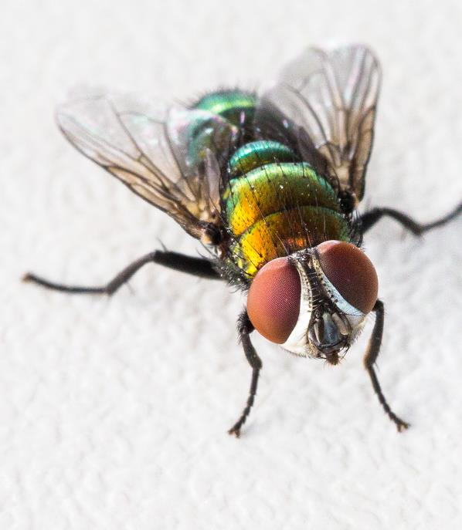
Presence of flies
The main culprit of flystrike:
Australian sheep blowfly
(Lucilia cuprina)
Notes:
So, that covers weather conditions which is one of the requirements for strike. The next condition required for flystrike which we will talk about is the presence of flies.
You’ll hear more about the culprit as we work through today’s presentation but let’s introduce you to Lucilia cuprina.
A pretty name but this fly, generally known as the Australia sheep blowfly, is responsible for initiating 90% of flystrike in sheep.
As you can see, it’s a very distinctive looking blowfly.
After the Australian sheep blowfly has initiated a strike, other species of fly may attack the animal and these can cause additional damage which is sometimes more severe.

Slide 11

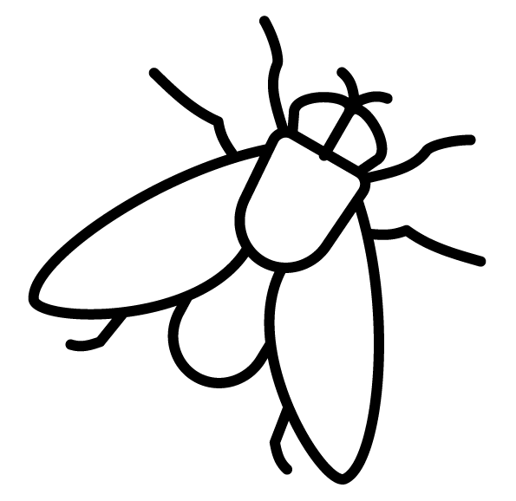
Presence of susceptible sheep
Some sheep are more inclined to be struck.
More sheep at risk…
The greater the risk
of flystrike
Notes:
The final requirement for flystrike is susceptible sheep.
Some sheep are more inclined to be struck than others and are more at risk than others.
The number of susceptible sheep is a key factor influencing the extent of flystrike in a mob.
The more sheep at risk in the mob, the greater the risk of flystrike.

Slide 12
What makes sheep susceptible to flystrike
Notes:
So what makes sheep susceptible to flystrike?

Slide 13
Susceptible sheep may have:
horns
wounds
previous strike
yellow wool
dermatitis
breech wrinkle
dags
breech wool
sweaty polls
moist wool and skin
urine stain
fleece rot
adhered afterbirth
Notes:
There are a range of factors that make sheep susceptible to flystrike, including:
breech wrinkle;
dags caused by scouring;
urine stain;
wool cover in the breech area;
wool that is yellow;
fleece rot and dermatitis;
wet or moist wool and skin (that can be caused by rain, dew and chewing behaviour from lice or grass seeds etc.);
horns (wounds from fighting and trapped moisture);
afterbirth adhered to the breech area;
‘sweaty’ polls (wool grease in the poll depression that gets moist and smelly);
wounds caused by skin tears, abscess, dog bites, grass seeds, lice or footrot etc.;
Many of these conditions require moisture for flystrike to occur, moisture causes odour and this combination is attractive to flies.
Sheep with dry dags, stain and afterbirth are low risk; however, the breech and tail can get wet and or damp at anytime (not just from rain) and can stay damp for extended periods of time which increases the risk of flystrike.
GUIDANCE
yellow wool is caused by an increase in suint which is dried sweat (not wool grease)
fleece rot = flaky/matted bands (discharge)
dermatitis = lumpy wool/hard lumps (bacteria)
afterbirth is problematic only if wet and if you haven’t crutched before lambing

Slide 14
Other risk factors
Conformation, structure and tail length
Notes:
There are other risk factors.
Some sheep may be at greater risk of flystrike because of their conformation or structure, which leads to their wool staying wetter for longer.
For example, sheep with high and wide shoulder blades which creates a dip between the should blades, or dipping in the neck or back are more susceptible to fleece rot and body flystrike.
In addition tail length makes sheep more susceptible to flystrike as it impacts the ability for the sheep’s breech area to dry out. We will address tail length specifically later in the session.

Slide 15
Other risk factors
Conformation, structure and tail length
Age and management:
  lambs and weaners vs. mature sheep
  classed vs. unclassed and cull sheep
Notes:
Some mobs will have a different risk profile due to their age or how they have been managed.
Lambs and weaners are higher risk compared to mature sheep as they have different wool characteristics (e.g., more colour) and are unclassed.
Unclassed mobs are more susceptible because you haven’t taken out the issues that make them susceptible.
Classed sheep are lower risk compared to unclassed and cull sheep:
Classed sheep will generally be less susceptible to fly strike as they have been bred and retained as they have favourable characteristics.
Unclassed sheep will include cull sheep which in turn include those removed because of wool and conformational faults which predispose them to flystrike.

Slide 16
Other risk factors
Conformation, structure and tail length
Age and management:
  lambs and weaners vs. mature sheep
  classed vs. unclassed and cull sheep
  ewes with different lambing or crutching and shearing dates
  protracted lambing periods
Notes:
Ewes with different lambing or crutching and shearing dates as well as their lambs and weaners will be higher risk than those with tight lambing windows. The risk profile of a mob will vary depending on when the sheep were crutched or shorn and if, or when, they lamb.
Protracted or different lambing times can extend the period that the ewes and the lambs or weaners are susceptible to flystrike during the production cycle.
For example, a protracted lambing may lead to a delayed lamb marking which delays the opportunity to apply preventative treatments (e.g., mulesing, chemicals, etc.) to both lambs and ewes. It may also move lamb marking from a low risk time of the year to a high risk time of the year.
If you condense your lambing period you condense the longevity of the problem. A protracted lambing period protracts the risk.
It is recommended that you condense joining so the lambing window is 5 weeks.

Slide 17
How to prevent flystrike
Notes:
Let’s have a look at how you can prevent flystrike.
Remember to avoid the panic – prevention is better than the cure.
Having an integrated flystrike management plan with broad ranging tools helps minimise strike without an over reliance on chemicals.

Slide 18
Classing and lamb marking
Reducing fly populations
Shearing
or crutching
Prevention
activities
Careful paddock selection
Applying preventative chemicals
Reducing scouring risk
and dags
Notes:
Preventative activities which help reduce the risk of flystrike include:
classing and lamb marking which includes removing sheep that are susceptible to flystrike, as well as mulesing high risk sheep and docking lambs tails to the optimal length when marking;
shearing or crutching to reduce wool length so wool dries more quickly, particularly around the breech. This also reduces the prevalence of dags;
applying preventative chemicals to sheep to protect against strike;
reducing the risk of scouring which causes dags;
careful selection of paddocks; and
reducing fly populations.
Let’s have a closer look at each of these preventative activities.

Slide 19
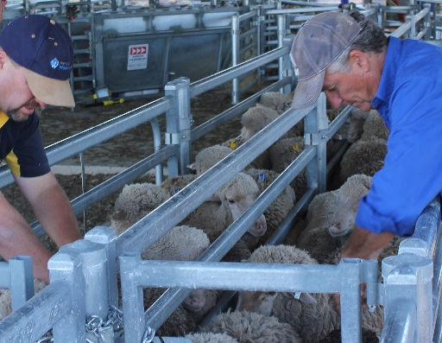


Classing
Identify susceptible sheep
Remove these from the flock
Breed for improved resistance
Workshop coming soon on breeding for improved flystrike resistance
Notes:
The aim with classing is to identify which animals are more susceptible to flystrike or have been struck in the past and remove these from the flock.
By doing this you increase resistance in your flock.
In the long-term you want to aim to breed sheep that are less susceptible to flystrike.
We won’t go into this in today’s webinar but AWI’s Flystrike Extension Program includes a one day workshop “ClassiFly” coming soon that looks at how to achieve this.

Slide 20
Class out high risk sheep
high body and breech wrinkle
long breech wool cover
yellow wool colour
fleece rot and dermatitis
high scouring and dags
high worm egg counts
horned animals
previous flystrike wounds
issues with conformation and structure
Notes:
Traits you want to remove from your flock when classing sheep include:
high body and breech wrinkle
long breech wool cover
yellow wool colour
fleece rot and dermatitis
high scouring and dags
high worm egg counts
horned animals
previous flystrike wounds
issues with conformation and structure (as mentioned earlier: shoulders, back, tails etc.)
Remember that while you can select for low scouring and dags, this may still occur due to other reasons.

Slide 21
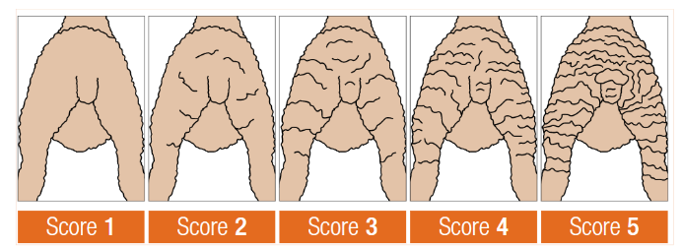
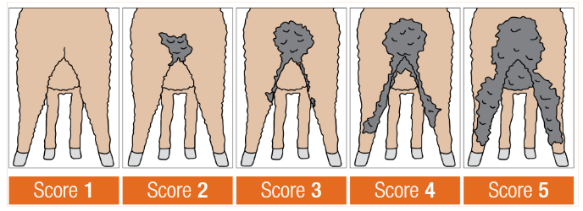
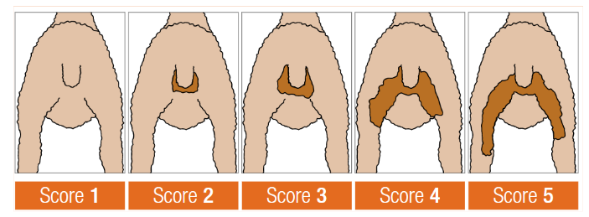
Class out high risk sheep - examples
Breech wrinkle
Dags
Urine stain
Breech cover
Source: AWI & MLA Visual Score Guide
Notes:
The AWI/MLA Visual Score Guide has some good examples of the type of sheep which are likely to be at higher risk of flystrike.
This Guide can be used to assist you class out susceptible sheep in order to prevent flystrike long-term.
This shows various degrees of breech wrinkle
The next one shows dags
Urine stain
And breech cover which is how much naturally bare skin there is around the breech
You can see here that those sitting around score 3 or greater are going to be at an increased risk of flystrike so you would use these scores as guides for removing higher risk sheep from the flock.
The ClassiFly workshop mentioned earlier that is being developed by AWI looks into making classing, selection and joining decisions to improve these scores and breed naturally flystrike resistant and profitable sheep.

Slide 22
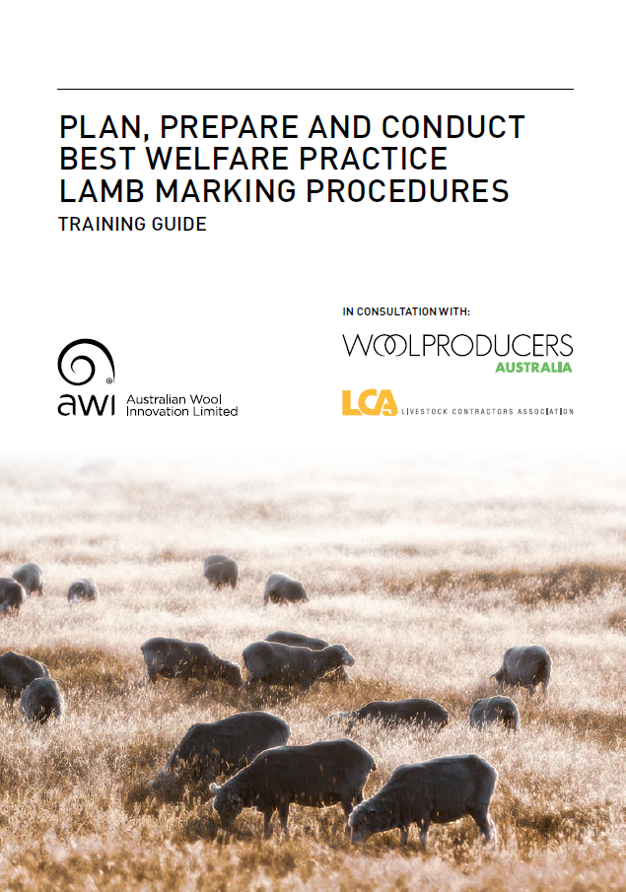

Lamb marking - Mulesing
If you deem the risk of flystrike in your sheep is high and they require mulesing - ensure that best practice procedures are used.
Two guides are available from AWI
www.bit.ly/BP-Lamb-Marking
www.bit.ly/Plan-Non-Mulesed
Notes:
If you deem the risk of flystrike in your sheep is high and they require mulesing - ensure that best practice procedures are used.
Two resources are available from AWI that will help.
The first is a training guide to help you plan, prepare and conduct best welfare practice lamb marking procedures (shown on the left here).
The second resource is a booklet that provides assistance when planning for a non-mulesed Merino enterprise (shown on the right here).

Slide 23
Lamb marking - Tail docking
Optimal tail length helps:
Channel urine and faeces away from breech area
Minimise breech stain and reduce flystrike
Protect from sun exposure and cancer
Notes:
Another long-term preventative activity is docking lambs tails to an optimal length when marking.
Tail wool and skin that is stained or wet from urine and faeces can attract flies.
There is an optimal tail length which helps channel urine and faeces away from the breech area.
This minimises stain around the breech and reduces flystrike risk throughout the sheep’s life.
It also helps to prevent prolapse (common in sheep with very short tails) and protects soft tissue from cancers caused by sun exposure.

Slide 24
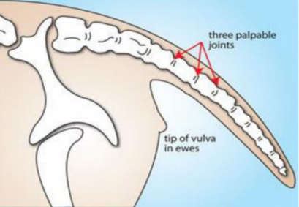
Lamb marking - Tail docking
Immediately below 3rd or 4th palpable joint
Source: FlyBoss
Notes:
When marking lambs, the recommended tail length ensures the healed tail just covers the vulva.
This means docking immediately below the third or fourth palpable joint or through the third or fourth joint space. Palpable means the joint that can be easily felt.
Male lambs should have their tails docked to the same length as ewe lambs.
The length is important because it means enough muscle remains so that the sheep can lift the tail high in the air which then puts vertical tension on the breech skin creating a “channel” for urine.

Slide 25




Shearing and crutching
Protects up to six weeks
Timed to extend protection over the fly season
Consider periods of high-risk in your area
- reduced to three if scouring
Notes:
A short-term preventative activity is shearing and crutching.
These activities can provide up to six weeks protection from body and breech flystrike. If sheep are scouring, this protection may be reduced to three weeks.
Shearing or crutching should be planned to coincide with the start, or just before the usual start of the fly season.
This is to reduce the number of susceptible sheep when the flies become active after winter. This is particularly important for lambing ewes that may have more stain around their breech.
Carefully consider the timing of shearing and crutching.
Aim to extend the period of protection over the fly season as much as possible by ‘spacing’ out these activities, bearing in mind the usual high-risk periods for flies in your area and other critical events such as lambing.
Handling ewes with lambs at foot when crutching can be difficult so time your activities to avoid having to do this.

Slide 26
Applying preventative chemicals
Insecticides:
Are used in combination with other activities
Should not be relied upon alone
Can be used preventatively or as a treatment
Make sure you use the right
chemical for the task
Notes:
Insecticides can be used in combination with other preventative activities to deter flies but they shouldn’t be relied upon alone.
These chemicals are registered to be used as either a preventative treatment or to treat struck animals (called ‘dressings’). Some chemicals only provide protection and will not kill maggots.
We will cover treating flystrike further in this session.
It is vital you use the right chemical for the task and follow the label instructions.

Slide 27
Applying preventative chemicals
Provide 4 weeks to 29 weeks protection (~)
Residual but will wear off
Timing should extend protection
Effective chemical use is essential
Notes:
The use of preventative chemicals is a short-term tactical tool providing protection from flystrike for between 4 weeks to 29 weeks (highly variable).
Most pesticides affect the nervous system of the insects, each in slightly different way. Preventative chemicals are residual meaning they continue to effect maggots and flies which make contact with them however from the time of application, the chemicals start to ‘wear off’ becoming less effective over time.
Where possible, time applications to extend the protection period.
For example, if you shear in early December, applying a preventative chemical six weeks later in mid-January will help to protect the sheep when the wool becomes long again.
Effective chemical use is crucial to ensuring the chemicals you use are as effective as possible.

Slide 28





Effective chemical application
Select the right chemical for the job
Apply the right dosage
Read and follow label instructions
Use the right application method
Ensure appropriate wool length
Regular monitoring is important even with preventative chemicals
Notes:
Effective chemical application means you need to make sure you:
select the right chemical for the job – the different chemicals and their uses will be covered shortly.
apply the chemical using the right application method;
Using the right application method means the applicator that comes with the chemical as that is what is approved for use as well as the application pattern for example poll to tail backline or side etc.
apply the right dosage;
Don’t just guess and make sure you fill the applicator to the correct dosage each time. Try to avoid a half dose because the applicator didn’t fill or you only get part way along the application pattern and then having to apply more.
check the wool length is appropriate for the chemical being used;
Some chemicals are made to be applied off-shears, in short wool or in long wool. Make sure you check the length.
and while this is last it’s really the first thing you should do - read and follow the label instructions, even if you have used the chemical before (some steps may have changed).

Slide 29



Chemical groups
CHEMICAL GROUP
ACTIVE CHEMICAL
APPLICATION METHOD FOR FLY
LABEL
PROTECTION
PERIOD
LICE
Pour/
Spray-on
Jetting
Dipping
Dressing
Organo-phosphates (OPs)
Diazinon
Not specified
Alpha-cypermethrin (body strike only)
Up to 10 wks
Synthetic Pyrethroids (SPs)
Imidacloprid
Up to 10 or 14 wks (wool length)
Neonicotinoids
Spinosad
Spinosyns
4-6 wks preventative
Ivermectin
Up to 12 wks low-mod fly pressure
Macrocyclic Lactones (MLs)
Cyromazine
Pour/spray-on:
Up to 11 wks
14 wks other methods
Insect Growth Regulators
Dicyclanil
11-29 wks based on strength
Always check the label
This table is general in nature and may change at any time
Notes:
It’s important to understand which chemical you will use as a preventative treatment.
There are different chemical groups with different active chemicals.
Application method for chemicals varies and different chemicals can be applied to different wool lengths.
Some chemicals prevent flystrike, some are for treating flystrike, some can go on open wounds (and some can’t).
The protection period for each chemical will vary as well.
Some chemicals used to treat or prevent flystrike can also be used to control lice, some of these can be applied differently. You also need to consider which chemicals you’ve used for lice control and which chemicals you want to use for flystrike prevention or treatment.
NOTE FOR DELIVERER
Each underlined point will bring up the information on screen – remember to explain the key at the bottom and the general nature of the table – always check the label.

Slide 30

Chemical resistance
CHEMICAL GROUP
ACTIVE CHEMICAL
Organo-phosphates (OPs)
Diazinon
Some chemical groups are no longer as effective
Synthetic Pyrethroids (SPs)
Alpha-cypermethrin (body strike only)
Neonicotinoids
Imidacloprid
Spinosyns
Spinosad
Macrocyclic Lactones (MLs)
Ivermectin
* Cyromazine
* Dicyclanil
Insect Growth Regulators
Notes:
Long term use and over reliance on just one chemical group for any type of pest control almost always results in resistance if good resistance management plans aren’t in place.
Some of the chemical groups that we used to rely on for blowfly control are no longer as effective because blowflies have become resistant to them.
A report recently showed resistance to cyromazine and dicyclanil in fly populations in different states. There is also cross-resistance between these two actives.
There has been some recorded cross resistance between dicyclanil and imidcloprid but this was in a limited sample and there’s further research required before this could be considered significant.
Resistance reduces the effectiveness of preventative chemicals and treatments or dressings over time.
If woolgrowers already have resistance on their property, this could result in shorter periods of protection than what they could normally expect, rather than a complete loss of effectiveness.
GUIDANCE
Diazinon - well known resistance, OPs have been removed from use as preventative treatments due to work health and safety risks.
Dicyclanil and cryomazine – widespread resistance in NSW and Vic, some resistance found in WA and SA.
Ivermectin and spinosad – no functional resistance.
Imidacloprid – indications that this is shifting towards resistance (may be due to lice control usage) but too soon to tell.
Sampling too small in Tas and no samples from Qld.
Pre-read: Blowfly insecticide resistance – research results and advice for woolgrowers:
https://www.wool.com/globalassets/wool/sheep/research-publications/welfare/non-invasive-management-practices/insecticide-resistance-study-btb-dec-2020.pdf

Slide 31
Chemical resistance
CHEMICAL GROUP
ACTIVE CHEMICAL
Organo-phosphates (OPs)
Diazinon
USE
Different chemical groups
Synthetic Pyrethroids (SPs)
Alpha-cypermethrin (body strike only)
Neonicotinoids
Imidacloprid
Spinosyns
Spinosad
Macrocyclic Lactones (MLs)
Ivermectin
* Cyromazine
* Dicyclanil
Insect Growth Regulators
Notes:
It’s important to understand chemical groups and active chemicals and not just brand names and ensure you use different chemical GROUPS.

Slide 32
Don’t be fooled…
CHEMICAL GROUP
ACTIVE CHEMICAL
Different product names
Different chemical groups
Organo-phosphates (OPs)
Diazinon
Synthetic Pyrethroids (SPs)
Alpha-cypermethrin (body strike only)
Neonicotinoids
Imidacloprid
Spinosyns
Spinosad
Macrocyclic Lactones (MLs)
Ivermectin
Cyromazine
Dicyclanil
Insect Growth Regulators
Notes:
Some products have very different commercial or brand names but use the same active chemical, meaning they will have the same effect on flies.
If flies are resistant to one product they will also be resistant to another, if both products contain the same active chemical.

Slide 33
Don’t be fooled…
CHEMICAL GROUP
ACTIVE CHEMICAL
Same product name
Same chemical
Same concentration
Organo-phosphates (OPs)
Diazinon
Synthetic Pyrethroids (SPs)
Alpha-cypermethrin (body strike only)
GROUP 4 Nicotinic acetylcholine receptor competitive modulators
Neonicotinoids
Imidacloprid
Spinosyns
Spinosad
Macrocyclic Lactones (MLs)
Ivermectin
Cyromazine
Dicyclanil
Insect Growth Regulators
Notes:
Also be aware that some products have very similar names and contain the same active chemical but are of different concentrations
NOTES FOR DELIVERER
Reiterate that just because there is resistance doesn’t mean you shouldn’t use it, you just have to be smart about how you use it.

Slide 34
Indicators of resistance
Flystrike in multiple sheep that have been treated with the same chemical rather than just in a few sheep
A shortening of the protection period (that is specified on product labels)
Resistance does not mean chemicals have totally lost effectiveness – rather the period of protection may be less than what you previously expected.
Notes:
There are two key indicators of resistance:
a shortening of the protection period (that is specified on product labels) – despite no change in application rate, the chemical was correctly applied and no significant differences in season outlook or fly pressure.
For example rather than 10-14 weeks protection you may start seeing signs of flystrike after 4-6 weeks.
flystrike in multiple sheep that have been treated with the same chemical rather than just in a few sheep – maggots survive and continue to cause strike (again despite confidence that the chemical was applied appropriately).
Resistance does not mean chemicals have totally lost effectiveness – rather the period of protection may be less than what you previously expected.

Slide 35
Limit or prevent chemical resistance
YOUR SITUATION
OBJECTIVE
Chemical resistance
IS a problem
Limit further resistance
Chemical resistance is NOT a problem (yet)
Keep this status
Notes:
If you think chemical resistance is already a problem on your property, you need to work on limiting further development of resistance.
If you think chemicals are still effective, you need to work to keep this status.

Slide 36
Resistance testing
NSW DPI is conducting resistance testing
Open to all woolgrowers around Australia
Get a collection kit from NSW DPI
Collect 60 live, healthy Lucilia cuprina maggots
Send your sample to NSW DPI
Notes:
Everything you have just heard is summarised in a handy one page document which helps woolgrowers understand chemical resistance better.
It includes contact details for resistance testing.
The testing is open to woolgrowers all around Australia.
AWI has a factsheet available that includes information on how to arrange for testing.

Slide 37
Three considerations for chemical rotation
PREVENTION
01
Consider the chemical group that was last applied (either earlier this season or at the end of the previous fly season) and where practical, avoid using a chemical from the same group next
02
LICE CONTROL
Consider the chemical group that was last used to control lice and avoid using a chemical from the same group for the next preventative flystrike application in the same season
03
TREATMENT
Consider the chemical groups that were last applied to prevent flystrike and avoid using these as a dressing to treat struck sheep this season
Notes:
Good chemical use will prolong the effectiveness of the chemicals we have available for flystrike.
Rotating chemicals is a good practice to help with this and there are three key considerations when it comes rotation:
Consider the chemical group that was last applied (either earlier this season or at the end of the previous fly season) and where practical, avoid using a chemical from the same group next.
Consider the chemical group that was last used to control lice and avoid using a chemical from the same group for the next preventative flystrike application in the same season.
Consider the chemical groups that were last applied to prevent flystrike and avoid using these as a dressing to treat struck sheep this season
DELIVERER NOTES
Flystrike prevention is complex and these are very simplified guidelines.
The important point is that you don’t use the same chemical group consecutively for flystrike prevention, lice control or to treat struck sheep.

Slide 38
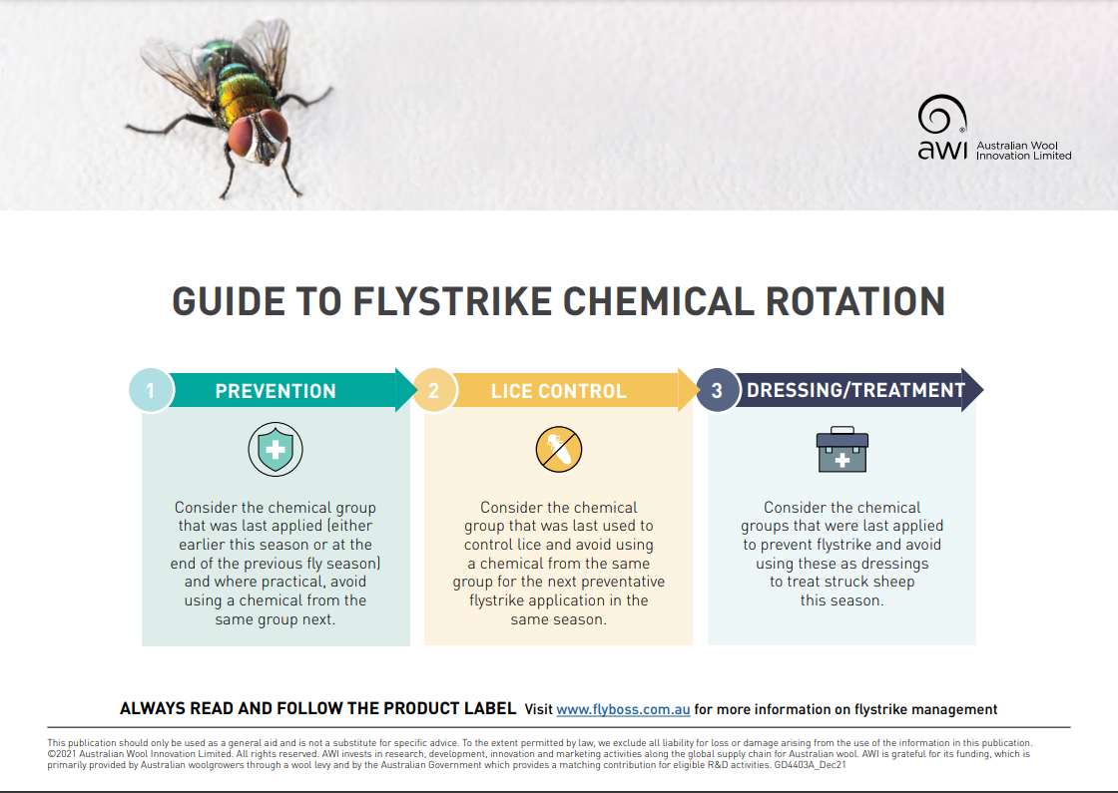
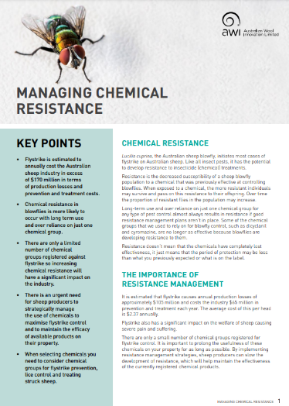
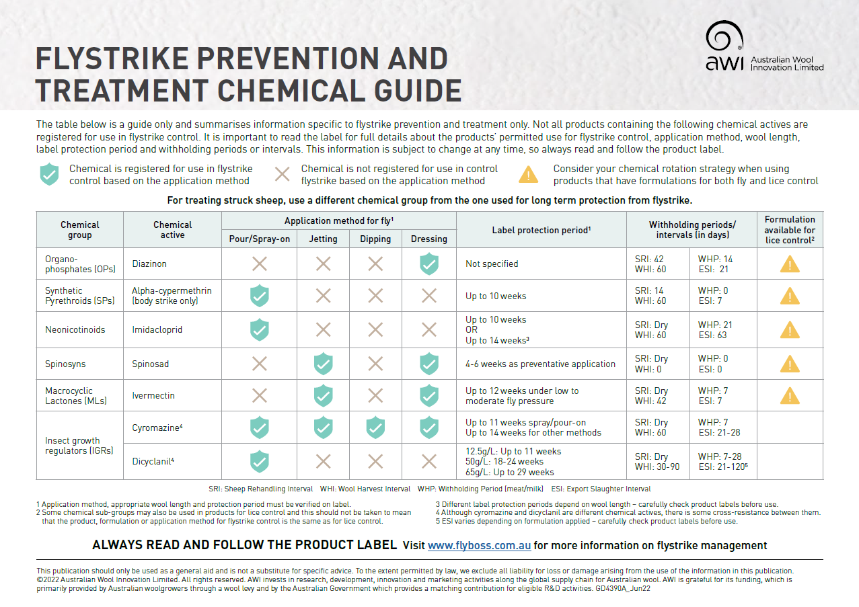
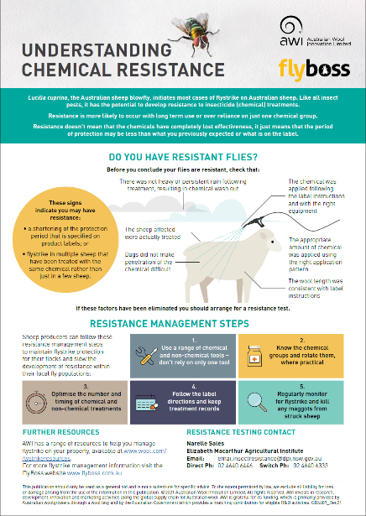


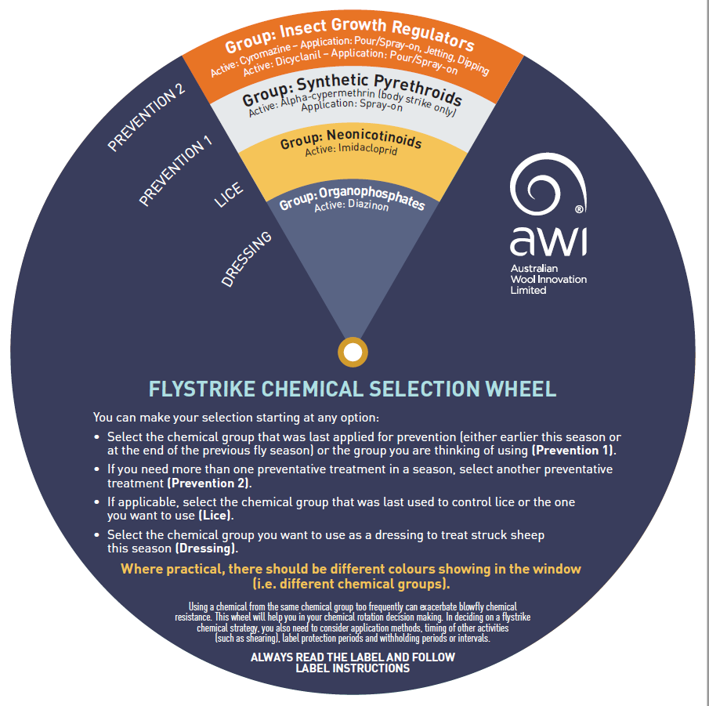


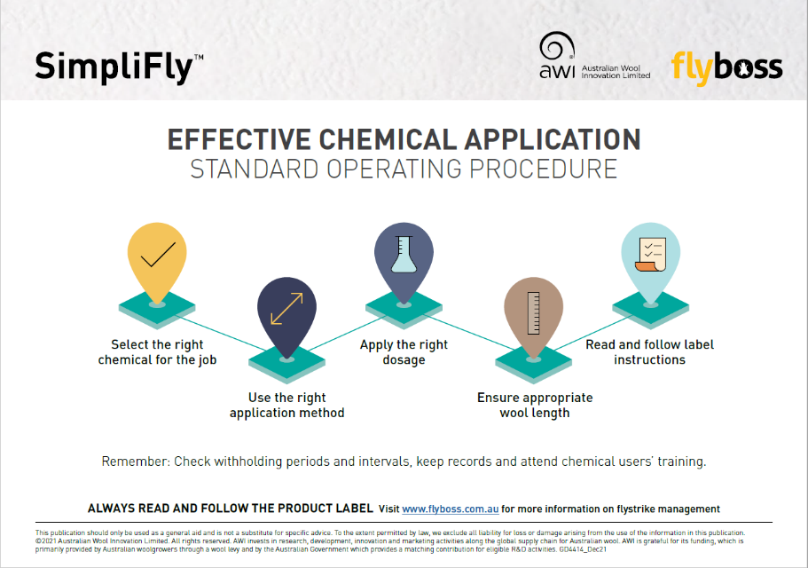
Chemical resistance is complex
www.wool.com/demystifly
Notes:
Chemical resistance is complex and effectively using chemicals to minimise resistance can be challenging.
AWI has developed a range of resources that can help you understand and manage chemical resistance.
Much of what you’ve heard here so far is included in these resources including:
an A3 sized standard operating procedure that covers effective chemical application. The poster is designed to go up in the shed and help communicate these points with all staff;
a guide that provides a summary of the chemicals groups and actives that are available to use for the prevention and treatment of flystrike;
a factsheet on chemical resistance that includes information on how to arrange for testing;
a guide to chemical rotation; and
a decision support tool to help you consider different approaches to flystrike chemical use based on the rotation practices we’ve heard about.
All of these can be downloaded or ordered in hardcopy from www.wool.com/demystifly

Slide 39

Classing and lamb marking
Reducing fly populations
Shearing
or crutching
Prevention
activities
Careful paddock selection
Applying preventative chemicals
Reducing scouring risk
and dags
Notes:
We have discussed:
classing and lamb marking which includes removing sheep that are susceptible to flystrike, as well as mulesing high risk sheep and docking lambs tails to the optimal length when marking;
shearing or crutching to reduce wool length so wool dries more quickly;
applying preventative chemicals to sheep to protect against strike;
It’s now time to consider:
reducing the risk of scouring which causes dags;
careful selection of paddocks; and
reducing fly populations.

Slide 40


Reducing scouring risk and dags
Scouring, dags and stain
Breech stays warm and moist
Ideal conditions
to attract flies
and for eggs to hatch
Notes:
Another preventative activity is to reduce scouring.
Scouring can cause dags to form rapidly.
Dags can then cause the wool and skin around the breech to stay moist and warm, creating an odour which attracts the female fly looking to lay eggs. This environment provides a suitable site for female flies to lay eggs and for maggots to develop.
Preventing scouring and dag formation is an important step to improve animal welfare and reduce the risk of breech strike.

Slide 41


Reducing scouring risk and dags
Monitor worm populations
Drench appropriately
Rotate drenches - use multi-actives
Avoid sudden changes in diet
Notes:
Worms can cause scouring so controlling the risk of scouring is an important preventative activity.
To control worms you need to:
Monitor worm populations using faecal egg identification and counts, and drench when required.
When drenching, remember to use the right drench for the job and at the right dose.
Rotate drenches and use drenches with multi-actives when possible. More information on this can be found at wormboss.com.au
Avoid sudden changes in diet that may induce scouring such as the introduction of grain or forage crops.
If you live in an area where there is a high risk of dags occurring, having a breeding objective to lower dags may be worthwhile to consider.

Slide 42
Careful selection of paddocks helps manage flystrike
Open paddocks with more wind
Less timber and wet
areas
Low worm
risk pastures
Notes:
Putting more susceptible sheep in certain paddocks is another key prevention activity.
Select paddocks that help mitigate the environmental factors that contribute to flystrike and avoid hotspots that encourage fly activity.
This might include paddocks that:
are more open and exposed to wind;
have less timber and wet areas; and
have a low worm risk.
Fly activity will be reduced in these paddocks and sheep will dry out more quickly and low worm risk paddocks will help prevent scouring.

Slide 43
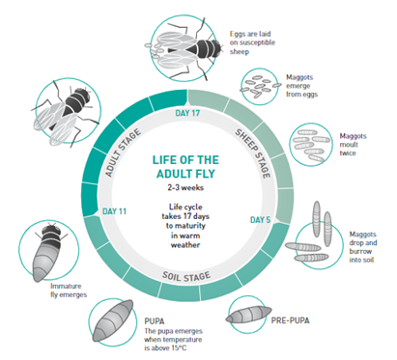
Reducing the presence of flies
The lifecycle of Lucilia cuprina, the Australian sheep blowfly
Source: Levot (1999) from Managing Breech Flystrike (2019), AWI
Notes:
The final preventative activity I’ll cover is focused on reducing the presence of flies.
The Australian sheep blowfly female prefers to lay its eggs on live sheep. Damp, smelly wool is their ideal environment.
Within 12-24 hours, the eggs hatch into maggots (larvae) which grow by feeding on the sheep through wounds, existing strike sites and weeping skin.
The maggots drop off the sheep after about 3-5 days and burrow into the ground about 1-4cm to pupate before emerging as immature flies about a week later. Soil temperature needs to be greater than 15ºC for this to occur.
To reach reproductive maturity and to produce eggs, adult female flies need a source of protein.
The sources of protein include exudate from wounds, existing strikes, weeping skin, carcases and protein-rich manure.
Other fly species that can cause secondary infections may also use these sources of protein (including carcases, animal and household waste) to lay eggs and to hatch maggots.

Slide 44


Reducing the presence of flies
REMOVE and dispose of infected material and carcases of sheep that have died from flystrike
COLLECT and kill
any maggots
MANAGE at isolated sites to make a difference across a bigger area
Notes:
Removing flies from the equation can contribute to preventing strike in the first place although reducing the susceptibility of sheep has a larger role to play in flystrike prevention.
Some steps you can take to help reduce the presence of flies are:
Remove and dispose of any fleece or waste animal matter (dags, dirty wool, horn tips, tails etc) to eliminate these as a source of protein for both the Australian sheep blowfly and other flies. Carcases of sheep that have died from flystrike should also be removed and disposed of – ideally by burying them. Although carcases aren’t a big part of the lifecycle for the Australian sheep blowfly, many maggots may be able to complete their development before other fly species infect the carcase and out compete them.
Collecting maggots from wool clippings when you’ve treated an animal is also important. It might not be something you automatically think about but doing this helps reduce the number of flies. Prevention is better than treatment.
Remember that flies do not generally travel far (about 3 km) so managing them at isolated sites and at a property level can make a significant difference to the level of flystrike on individual properties.
Importantly, these activities that help reduce fly populations should be timed before the first emergence of flies from the pupae stage – and not just within the fly season.

Slide 45
Classing and lamb marking
Reducing fly populations
Shearing
or crutching
Prevention
activities
Careful paddock selection
Applying preventative chemicals
Reducing scouring risk
and dags
Notes:
So that covers the full range of prevention activities.
A combination of these activities is best rather than relying on any single activity alone and should be considered in your integrated flystrike management plan.
Don’t forget, at the end of the fly season, reassess your flystrike management plan and make changes where necessary.
Think about what worked well to prevent flystrike, and what didn’t. Don’t forget to think about why some sheep got struck but others didn’t - where they managed differently or do they have different traits that made them more susceptible?

Slide 46

Take to the farm messages
1
Well-timed, preventative activities can help reduce the risk of flystrike
2
Some types and classes of sheep
are more susceptible to flystrike
3
A well thought out integrated flystrike program is crucial
Notes:
Now to summarise what we’ve discussed for prevention:
Well-timed preventative activities can help reduce the risk of flystrike.
Some types and classes of sheep are more susceptible to flystrike and should be targeted for preventative treatment.
A well thought out integrated flystrike program is required. Make sure you have a plan that includes the preventative activities we’ve covered today.

Slide 47
Take to the farm messages
4
No single preventative activity should be relied upon alone
5
Monitoring is required even with the use of preventative activities
6
Flystrike management considers prevention, monitoring, treatment
Notes:
No single preventative activity should be relied upon alone – make sure you use a range of well-timed activities in combination.
Monitoring activities (which we will hear about next) are still required even with the use of preventative activities including the use of preventative chemicals. Constant vigilance is crucial.
Effective flystrike management requires the combination of prevention, monitoring and treatment activities – which we will shortly cover.

Slide 48
Questions
Prevention
Monitoring
Treatment
Notes:
That brings us to the end of our section on prevention so we’ll check for questions before moving onto Monitoring.
FACILITATOR
Asks questions from participants and Deliverer answers.
If we can’t get through all of the questions, we will keep the questions and provide responses back in a follow up email.
[have three questions prepared]
Back to you xxx.

Slide 49
Progress check
Prevention
Monitoring
Treatment
Notes:
We’re going to look at monitoring activities to control flystrike

Slide 50
What we will cover - monitoring
Why monitoring is important
How to monitor for flystrike
Signs of flystrike
Questions
Notes:
During this section, I’ll cover a number of key items in relation to monitoring flystrike, this includes identifying:
why monitoring is important and the role it plays in short term flystrike management;
how to monitor for flystrike; and
the signs of flystrike.
We will also have time at the end of this section for questions before we move onto the final section regarding treatment of flystrike.

Slide 51
Why monitoring is important
Notes:
Let’s look at why monitoring is important.

Slide 52
The aim of monitoring
Detect and deal with flystrike as soon as possible to prevent:
Further suffering in fly struck animals
Increased flystrike across the flock
Negative impacts on:
  wool production
  condition and fertility
  growth and survival
Notes:
Monitoring flystrike is an important tool for woolgrowers to use, particularly when conditions indicate an increased risk of flystrike.
The aim of all monitoring activities should be to detect and deal with flystrike as soon as possible.
Doing so means you can:
stop the flystrike from worsening in individual animals and prevent further suffering of fly struck animals;
prevent fly populations increasing and flystrike spreading through the entire flock or your area – it’s better to prevent than have to treat the outcome; and
avoid negative impacts on wool production, condition, fertility, growth and survival due to poor health or damage due to strike.

Slide 53
How to monitor for flystrike
Notes:
So, how do you monitor for flystrike?

Slide 54
Monitor conditions required for flystrike
MONITOR STRIKE
IN SHEEP
MONITOR FLY
POPULATIONS
MONITOR WEATHER CONDITIONS
Notes:
Monitoring flystrike really means monitoring the conditions required for flystrike.
Remember, the conditions required are:
The presence of susceptible sheep;
The presence of flies; and
Favourable weather conditions.
Monitoring therefore means:
Monitoring strike in sheep, as well as their susceptibility to strike;
Monitoring fly populations; and
Monitoring weather conditions.

Slide 55



Monitor flystrike in sheep
CHECK SHEEP
1
2
LOOK FOR SIGNS
Regularly check sheep
in paddocks
Check the sheep for signs
of flystrike
Regularly check
sheep
Look for
signs of flystrike
TREAT ALL SHEEP
4
3
TREAT THE SHEEP
If strike occurs across a large number, treat the entire mob.
Remove struck sheep
for treatment.
Or treat the whole
mob
Treat the individual sheep
Notes:
Regularly checking mobs of sheep and carefully looking for susceptible sheep and signs of flystrike is an important part of flystrike management.
This is a particularly important activity when favourable conditions for flies occur.
Not only will this allow you to identify and deal with struck sheep but it will also allow you to monitor the severity of the flystrike event.
Checking sheep doesn’t have to mean bringing them into the yards but rather going around the paddocks and carefully looking at the sheep for signs of flystrike, scouring, staining and wet areas or wounded animals.
If you find signs of flystrike in sheep, remove the sheep for treatment.
If the strike appears to be more extensive and across a large portion of the flock, then you may need to bring the entire mob in for closer checks or for treatment.

Slide 56
Signs of flystrike
Notes:
When you are monitoring flystrike in sheep, it’s important to understand the signs of flystrike and how severe it is.

Slide 57
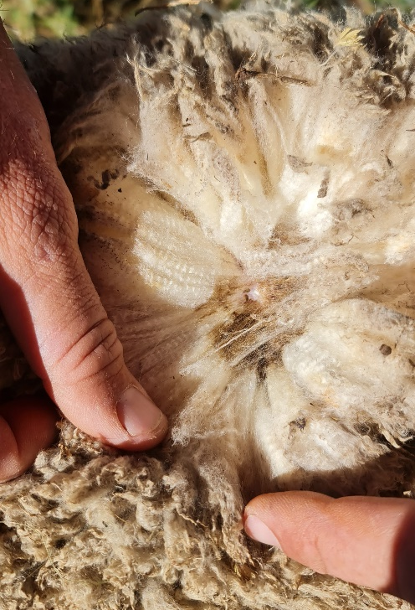
Covert flystrike
Covert flystrike is:
Common
Difficult to detect
Covert strikes can last for some
weeks and advance or resolve
Covert flystrike can be difficult to
detect unless handling sheep
Notes:
Small areas of flystrike that cannot be detected easily are quite common and are known as covert flystrikes.
They are difficult to detect unless you are looking closely at sheep, such as when handling them for crutching, shearing or marking.
Covert strike can last for some weeks before advancing into more obvious flystrike during warm, moist conditions or they can resolve without the need for treatment.

Slide 58
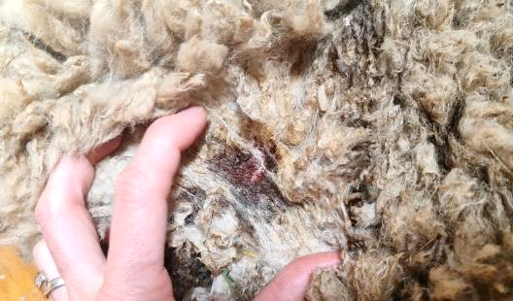
Early detectable flystrike
Early detectable flystrike signs:
Discoloured or chewed wool
Sheep behaviour
As soon as detected, implement
treatment and prevention
Discoloured wool may indicate early
detectable flystrike
Notes:
Early signs of flystrike which should be noted in a monitoring program include patches of wool that appear discoloured from chewing or rubbing.
These generally do not have a large strike wound but it will become progressively darker with more exudate or weeping).
Sheep also usually behave differently as they will be uncomfortable and irritated. They may twitch their tail, bite or scratch at the affected area if they can reach it, especially with breech strike. They may also stamp their feet, duck their head and arch their backs but will generally stay with the mob.
As soon as an early detectable strike is confirmed, implement treatment activities and take steps to prevent further flystrike from occurring.

Slide 59
Early detectable flystrike
Act now to prevent advanced strike:
Treat struck sheep
Work out cause of strike
Crutch or apply preventative chemicals
Increase monitoring
and prevention activities
Notes:
Start by treating all struck sheep and then work out why the strike has occurred.
This allows you to determine whether it is an anomaly, that is only one particularly susceptible sheep is affected, or if it is an indicator that an outbreak is imminent.
If the strike appears to have affected more than one particularly susceptible sheep, consider whether the strike occurred due to a management error (for example: poor or delayed crutching or chemical application error) or if it’s due to a particularly high risk period. This can help determine what the next course of action may be.
It’s important to increase monitoring and take action such as crutching or chemical preventions as soon as possible.
If shearers cannot be arranged, consider alternative options, such as additional jetting with a preventative treatment which may provide interim protection until shearing or crutching can be arranged.

Slide 60
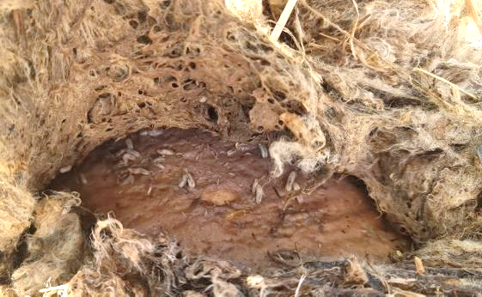
Advanced flystrike
Signs of advanced flystrike:
Wound is large, wet, dark and smelly
Mats of skin with maggots
Isolation, fatigue and loss of appetite
Treat immediately to promote
An obvious wound site
wellbeing - increase monitoring
Notes:
The signs of advanced strike are more obvious because the wounds are larger and there can be infection that can cause ‘whole of body’ effects for the sheep including fever and potentially sepsis or septic shock.
Wounds from advanced strike are large, wet, dark and smelly, and maggots will be moving outwards to consume healthy tissue. Big mats of wool may be peeling or hanging off.
Sheep will be suffering significant pain.
Sheep won’t be able to keep up with the mob when grazing and will often be found on their own. They will become increasingly affected by the flystrike, stop eating and drinking, will lie down and not want to get up.
Without treatment, sheep will generally die quickly, anywhere from a few hours to three or so days. If sheep with advanced flystrike are found, treat animals immediately and increase the frequency of monitoring as it is likely that more flystrike will occur in the following days or weeks.

Slide 61
Monitor conditions required for flystrike
MONITOR STRIKE
IN SHEEP
MONITOR FLY
POPULATIONS
MONITOR WEATHER CONDITIONS
Notes:
That that covers monitoring sheep, let’s have a look at monitoring fly populations.

Slide 62
Monitor fly populations
CHECK
Sheep camp
sites
CHECK
Watering
points
CHECK
Fly traps
(where used)
Notes:
Adult flies do not normally travel further than 3 km so sheep camps and watering points can act as epicentres for infection. Check these areas regularly for blowflies and struck sheep.
Remember – one step in the lifecycle is maggots dropping off struck sheep and forming pupae in the soil. So, it makes sense that where sheep spend a lot of time will be where a lot of flies emerge.
Some growers may use fly traps to assist with monitoring so these should be regularly checked.
If any Australian sheep blowflies are caught in traps or found around camps and watering points, this should be taken as a warning that flies are about and, given favourable conditions, flystrike could occur.

Slide 63
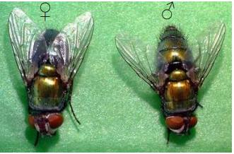
Monitor fly populations – adult flies
An adult female (left) and male (right) Australian sheep blowfly
Source: J Larsen, L Tyrell and N Andersen, The Mackinnon Project, University of Melbourne, from Early Season Treatment and the Control of Breech Strike in Unmulesed Sheep – A National R&D Technical Update (2010), AWI
Notes:
When monitoring fly populations, it’s important to know how to spot the different fly species so you can determine if the Australian sheep blowfly is about.
Many of you will be familiar with the Australian sheep blowfly but as a recap:
The adult Australian sheep blowfly is about 9 mm long (body length) and is a metallic green/bronze colour with reddish eyes.
You can see here the very distinctive colour.

Slide 64
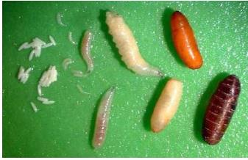
Monitor fly populations - blowfly larvae
Various stages of Australian sheep blowfly larvae development
Source: S De Cat and J Larsen, The Mackinnon Project, University of Melbourne,
from Managing Breech Flystrike (2019), AWI
Notes:
Egg-bearing female flies lay small white eggs on live sheep.
These larvae or maggots are creamy coloured and hatch within 12-24 hours of the eggs being laid.
The maggots drop off the sheep after about three days (around 13 mm in length) and burrow into the ground to pupate. The pupa become barrel-shaped as the outside shell hardens and darkens from yellow to red-brown.
When conditions are favourable, they emerge as immature flies about one week later.

Slide 65
Monitor conditions required for flystrike
MONITOR STRIKE
IN SHEEP
MONITOR FLY
POPULATIONS
MONITOR WEATHER CONDITIONS
Notes:
That covers monitoring fly populations, let’s have a look at monitoring weather conditions.

Slide 66
Monitor weather conditions
WARM
Temperatures
Soil: Above 15ºC
Ambient:
17-38ºC
WET
Regular and consistent
rainfall
high risk
CALM
Wind speed
under 9km/h (activity stops above 30km/h)
Monitor sheep carefully when favourable conditions occur
Notes:
Remember from the prevention section, consecutive warm, wet and calm days provide ideal conditions for female flies to lay eggs on sheep and are a good indicator that strike may occur.
Monitoring the weather helps you to know in advance when conditions are likely to favour flies.

Slide 67
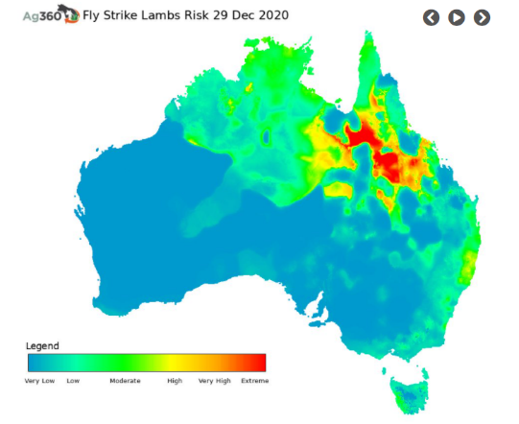
Check your risk at FlyBoss
Access free national risk
maps for flystrike
via FlyBoss
www.flyboss.com.au/sheep-goats/management/national-risk-maps
Notes:
A forecast of wetter than average conditions can be a valuable indicator of increased fly activity.
You can access free national risk maps for flystrike via FlyBoss.
[The current map is showing Dec 2020 for visual effect – try to use the most current map available when presenting, or visit the site live:
http://www.flyboss.com.au/sheep-goats/management/national-risk-maps.php

Slide 68
Monitor conditions required for flystrike
MONITOR STRIKE
IN SHEEP
MONITOR FLY
POPULATIONS
MONITOR WEATHER CONDITIONS
Notes:
And they are the key monitoring activities you need to be undertaking regularly.

Slide 69
Take to the farm messages
1
Monitoring activities help detect signs and conditions of flystrike
2
Monitoring is a combination of checking sheep, flies and weather
3
Monitoring is important even with the use of preventative activities
Notes:
Now to summarise what we’ve heard for monitoring:
Regular monitoring activities will help you to detect signs of flystrike in sheep as well as conditions which may favour flystrike. Finding these as early as possible helps prevent severe infections.
Monitoring involves a combination of checks including looking for flystrike in sheep, checking populations of flies and checking weather conditions.
Monitoring is an important activity to undertake regularly even with the use of preventative activities including chemicals.

Slide 70
Questions
Prevention
Monitoring
Treatment
Notes:
That brings us to the end of our section on monitoring so we’ll check for questions before moving onto treatment.
FACILITATOR
Ask questions from participants and Deliverer answers.
[have three questions prepared]

Slide 71
Progress check
Prevention
Monitoring
Treatment
Notes:
We’ve now covered prevention and monitoring so in this next section we’ll look at treating flystrike when it occurs.

Slide 72

What we will cover - treatment
How to treat flystruck sheep
Overall questions
Notes:
Treating flystrike is essential to protect the health and welfare of your flock, break the lifecycle of flies and prevent economic losses.
In this section, we will look at how to treat flystruck sheep.

Slide 73
How to treat flystruck sheep
Notes:
So, you were monitoring your sheep and you found a flystruck one, what do you do next?

Slide 74


Steps to follow
1
CLEAN THE STRIKE AREA
Clip wool close to the skin on the strike area and 5cm into clean wool around the site.
2
COLLECT & KILL MAGGOTS
CLEAN STRIKE AREA
Put wool and maggots into plastic bag, seal and leave in sun to kill maggots.
COLLECT & KILL MAGGOTS
MOVE TO ‘HOSPITAL’
4
MOVE TO ‘HOSPITAL’
DRESS INFECTED AREA
Move struck, treated sheep to a hospital paddock to reduce risk to rest of flock.
3
DRESS INFECTED AREA
Dress the infected area using suitable registered chemical to prevent restrike.
Notes:
The first step is to clean the strike area.
This means the area of the strike wound and around the wound.
Remove struck wool by clipping the wool on and around the infected area. Clip the wool close to the skin. Machine shearing with a hand piece is generally better than using manual hand shears as you can get closer the skin, removing more maggots and infected wool.
Clip into at least 5 cm, or one blow with a handpiece, of clean wool around the struck area to ensure all maggot trails have been exposed and create a buffer so the infected skin can dry out.
If you find maggot trails, follow these and clip out all infected wool.
Many maggots may escape treatment if care is not taken. Poor control of maggots can lead to further strike as well as resistance to treatment and prevention chemicals.
It is important to collect as many maggots as possible during treatment and kill them.
Don’t just kick the maggots and wool clippings down the chute if you’re in the shed.
To dispose of maggots effectively, place all clipped wool and all maggots into a plastic bag that can be sealed.
Leave the bag in the sun for several days to kill the maggots.
Once you’ve cleaned the site and cleaned up the wool and maggots, the next step is to dress the infected area.
Dress the infected area using a suitable registered chemical to prevent the wound from being restruck while it is healing.
After dressing the wound, you then need to move struck sheep to a ‘hospital’ paddock (if possible) to reduce the risk of attracting more flies to the rest of the flock. Provide the treated sheep with fresh feed and water, shelter and contact with other sheep and monitor them regularly.
When treating sheep with severe flystrike, it is best to consult your local vet as these sheep are at greater risk of death.
Make sure you follow all the steps described to effectively treat struck sheep, prevent additional strike and avoid the development of resistance to chemicals.

Slide 75
Take to the farm messages
1
Use a combination of treatment activities, not one single activity
2
Correctly treat sheep, kill maggots and remove protein sources
3
Flystrike management should also consider prevention and monitoring
Notes:
In summary, when it comes to treating flystruck sheep, make sure you use a combination of treatment activities and don’t rely on one single activity alone.
It’s important to make sure all flystruck sheep are effectively treated, all maggots are killed and sources of protein are removed to aid the sheep’s recovery and to prevent additional strikes.
Treatment of flystrike should be considered as part of a larger flystrike management plan which also incorporations prevention and monitoring activities, as we’ve heard about today.

Slide 76
Progress check
Prevention
Monitoring
Treatment
Notes:
That’s the end of our section on treatment and takes us to the end of three sections we had planned for today.
Before we move onto questions, just a final summary about key points from today.

Slide 77



Summary
Prevention, monitoring and treatment activities are all important but preventing flystrike is key.
Have an integrated plan for prevention, monitoring and treatment – review regularly
Prevention, monitoring and treatment activities consider sheep, flies and weather holistically
Notes:
Prevention, monitoring and treatment activities are all important but preventing flystrike is key.
Have an integrated plan for prevention, monitoring and treatment and review it review regularly. No single preventative, monitoring or treatment activity should be relied upon alone. Remember it’s a strategy, we’re using them all together.
These prevention, monitoring and treatment activities need to consider sheep, flies and weather holistically.
Ok, thank you everyone for your attention, I’ll hand over to [Facilitator] and we will go through questions.

Slide 78

Notes:
This presentation is one of a range of initiatives AWI has available or will soon be available that can help you manage flystrike short and long term.
There are a number of other learning opportunities available from AWI…
It’s Fly Time! Is a one hour webinar held in the lead up to high flystrike risk periods via AWI. The contents cover what you have heard in this presentation.

Slide 79

Notes:
DemystiFly - Practical information for woolgrowers and their advisors regarding managing blowfly chemical resistance.

Slide 80


Notes:
SimpliFly – A one-day workshop to help develop a strategic flystrike management plan and annual calendar that integrates many of the tools you’ve heard about today into an overall plan across your flystrike risk period.

Slide 81

Notes:
ClassiFly – A one-day workshop to increase skills and awareness in breeding for improved natural flystrike resistance.

Slide 82


Notes:
StrateFly – A one-day workshop to develop a whole-of-farm plan for moving to a non-mulesed Merino enterprise.

Slide 83


Notes:
AmpliFly - 1-on-1 coaching and support to implement your whole-of-farm plan for moving to a non-mulesed Merino enterprise.

Slide 84
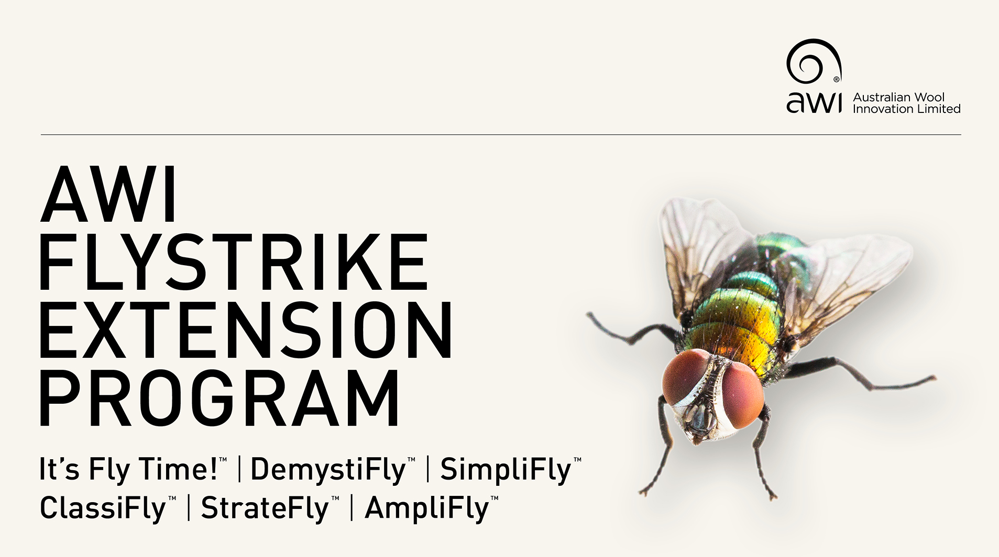
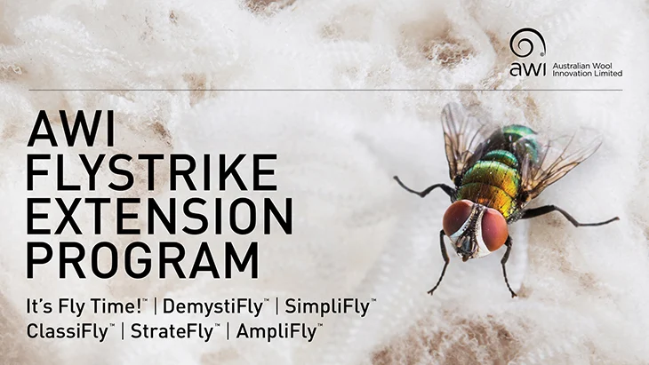
www.wool.com/flystrikeresources
Notes:
You can find out more about these initiatives from wool.com/flystrikeresources

Slide 85

Questions
Notes:
FACILITATOR
Thanks [Deliverer], that was terrific.
Summarise a key point or two from the webinar. E.g. how prevention, monitoring and treatment can’t be considered in isolation of each other and each contributes differently to effective flystrike management/getting the balance of activities right is key to effective flystrike management.
Ok, we’ll move onto questions either on the topic of treatment which we just finished or if there are any other questions overall about prevention, monitoring and treating flystrike.
Facilitator – asks questions from participants and Deliverer answers.
[have three questions prepared]

Slide 86
THANK YOU
NAME
COMPANY
M: xxxx
E: xxxxx
This publication should only be used as a general aid and is not a substitute for specific advice.
To the extent permitted by law, we exclude all liability for loss or damage arising from the use of the information in this publication.
© 2022 Australian Wool Innovation Limited. All rights reserved. AWI is grateful for its funding, which is primarily provided by Australian woolgrowers through a wool levy and by the Australian Government which provides a matching contribution for eligible R&D activities.

